Slide 1

人工智能编程实践
AI Programming Practice
授课教师：饶云波
电子科技大学 · 信息与软件工程学院
电子科技大学，中国⋅成都，2024年4月1日

Slide 2
Pytorch install
Most machine learning workflows involve working with data, creating models, optimizing model parameters, and saving the trained models. This talk introduces you to a complete ML workflow implemented in PyTorch, with links to learn more about each of these concepts.
We’ll use the FashionMNIST dataset to train a neural network that predicts if an input image belongs to one of the following classes: T-shirt/top, Trouser, Pullover, Dress, Coat, Sandal, Shirt, Sneaker, Bag, or Ankle boot.
Running the Tutorial Code
You can run this tutorial in a couple of ways:
In the cloud: This is the easiest way to get started! Each section has a “Run in Microsoft Learn” and “Run in Google Colab” link at the top, which opens an integrated notebook in Microsoft Learn or Google Colab, respectively, with the code in a fully-hosted environment.
Locally: This option requires you to setup PyTorch and TorchVision first on your local machine (installation instructions). Download the notebook or copy the code into your favorite IDE.

Slide 3
Pytorch install
Pytorch install
https://pytorch.org/

Slide 4
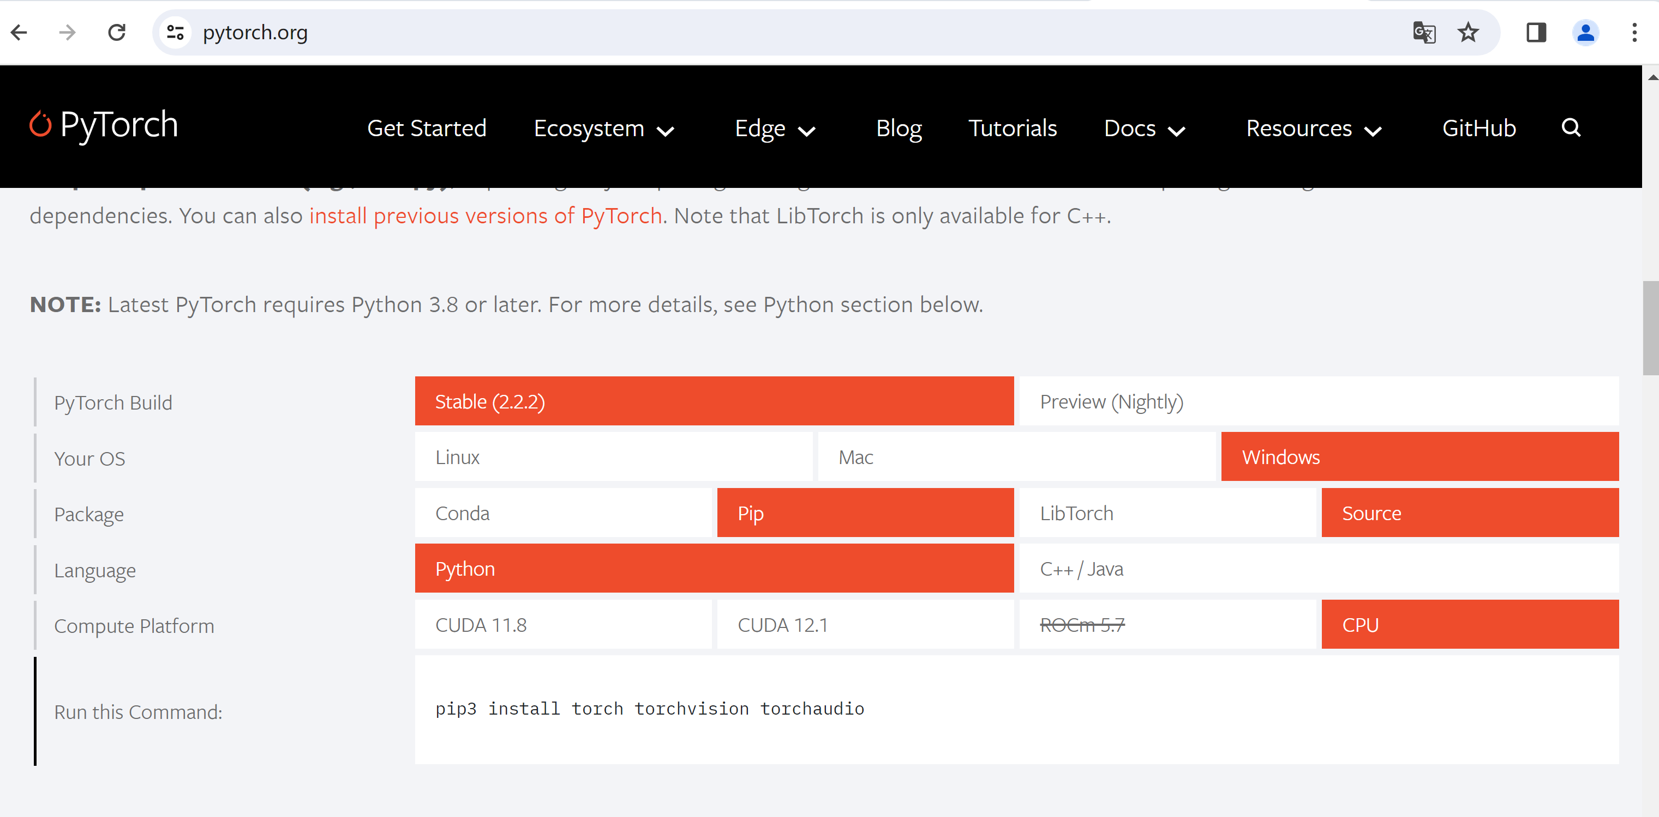
Pytorch install
https://pytorch.org/

Slide 5
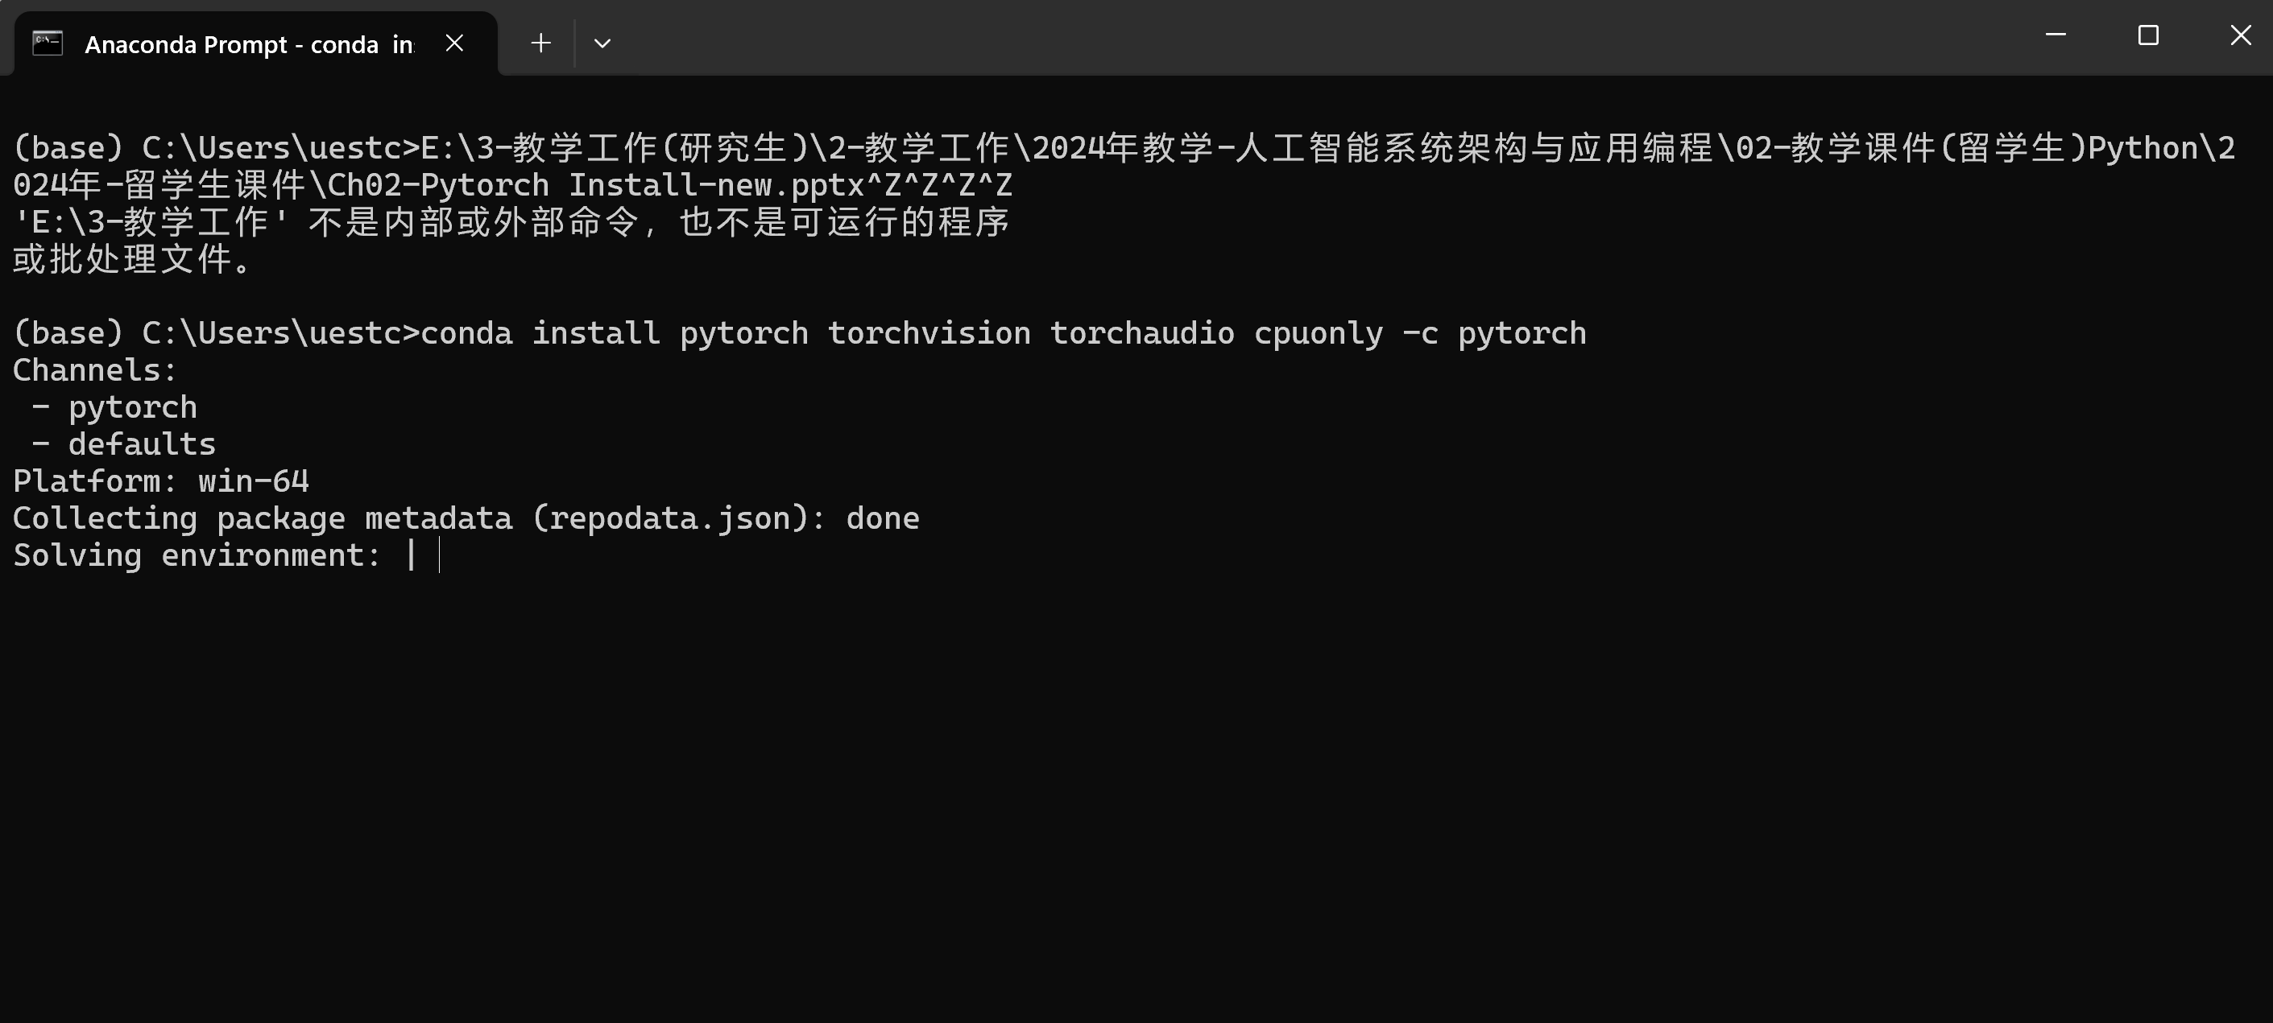
Pytorch install
conda install pytorch torchvision torchaudio cpuonly -c pytorch

Slide 6
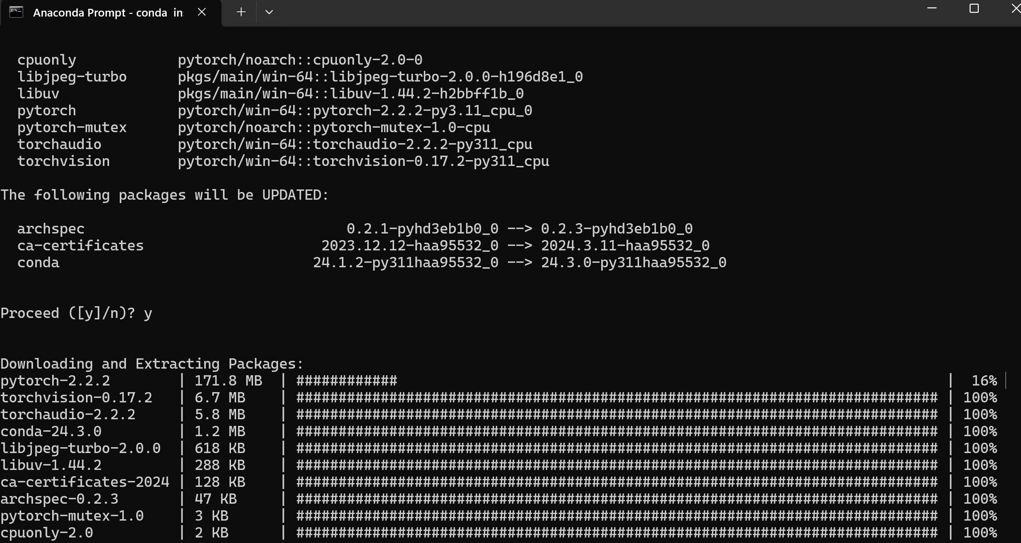
Pytorch install

Slide 7
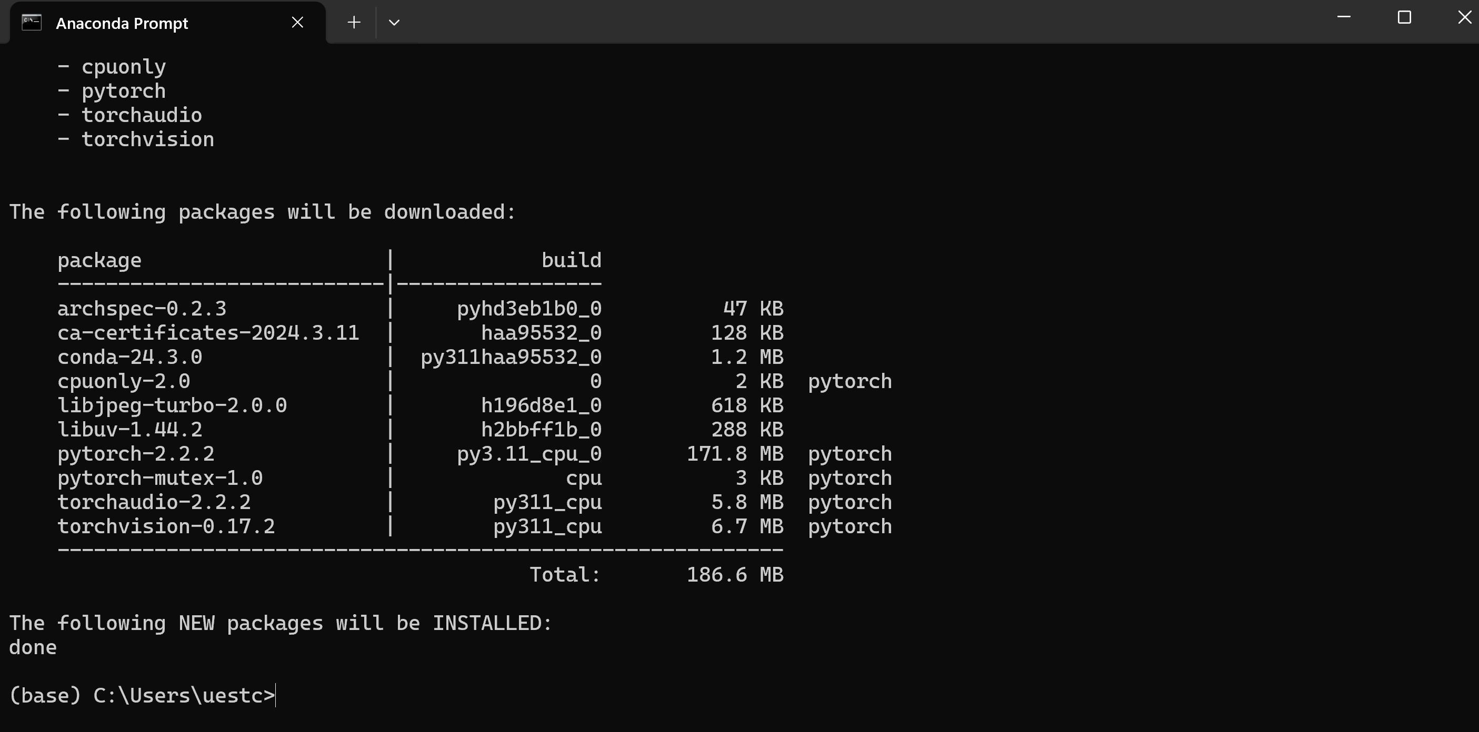
Pytorch install

Slide 8
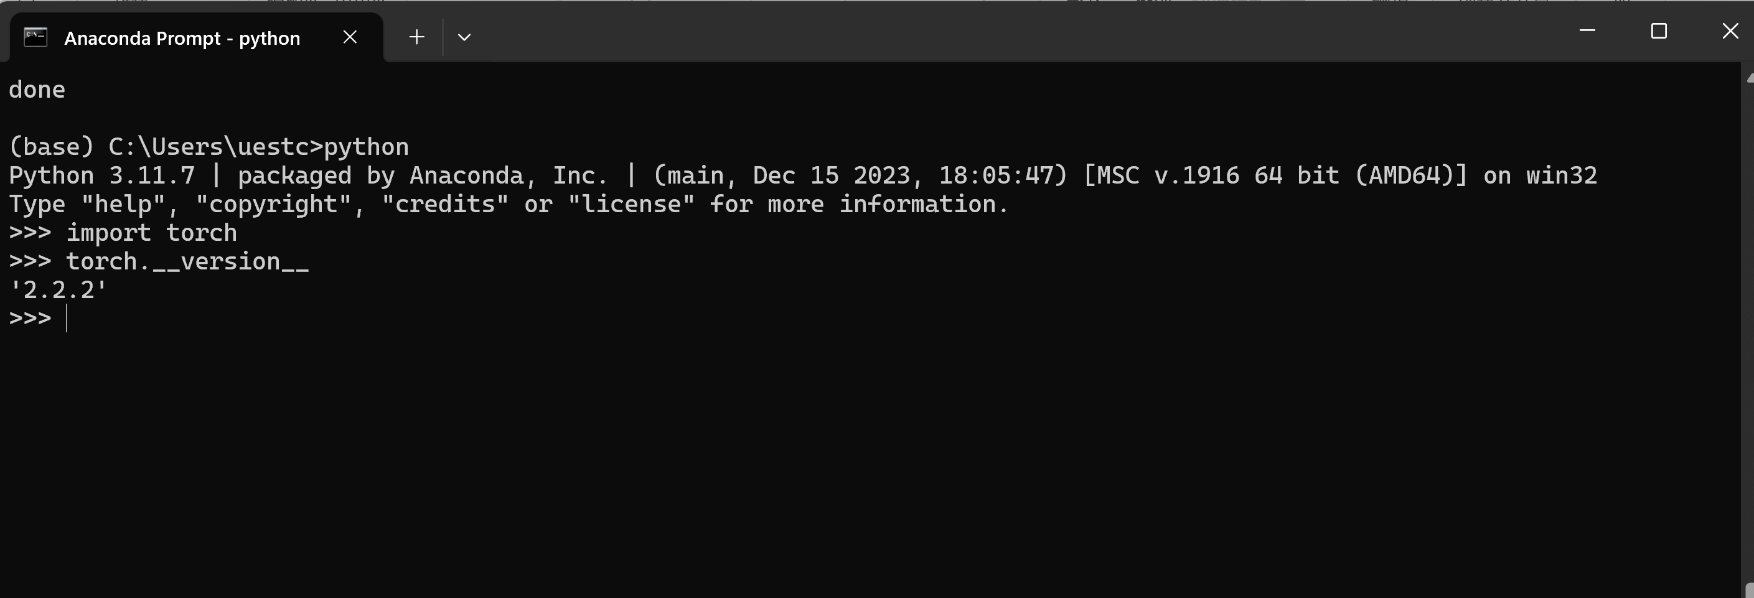
Pytorch install
Base environment don’t active

Slide 9
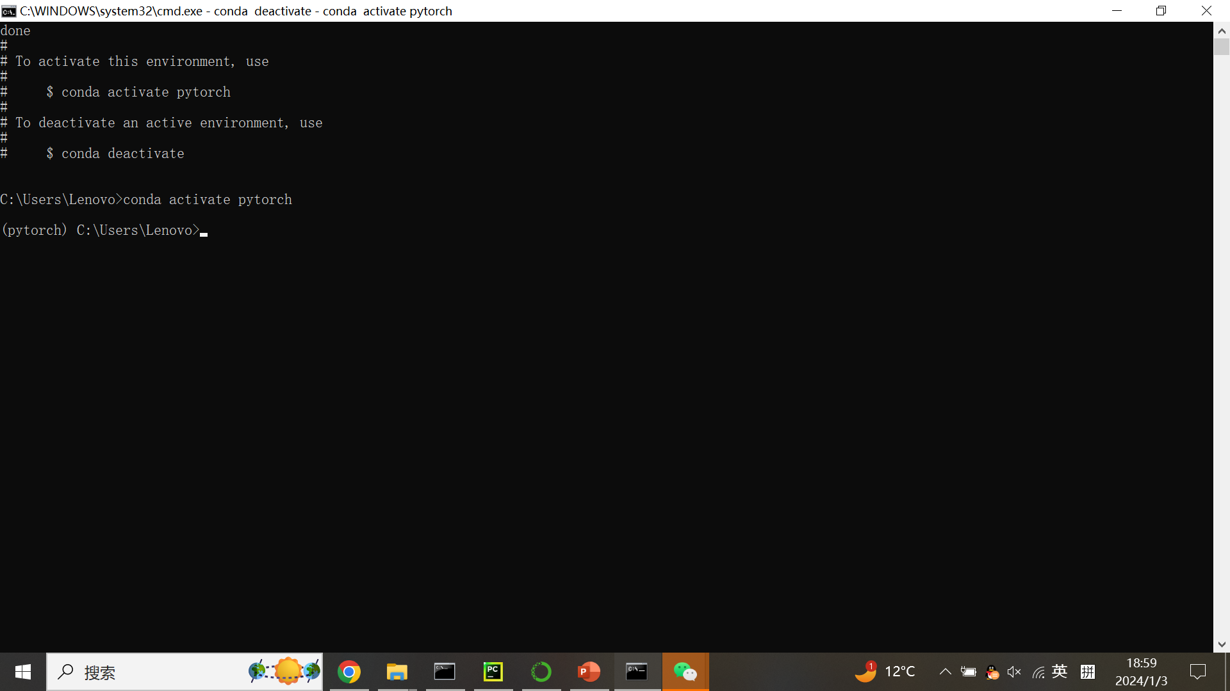
Pytorch install
Base environment don’t active

Slide 10
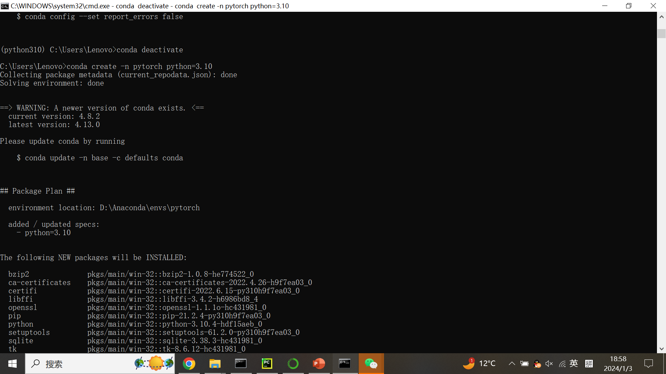
Pytorch install

Slide 11
Yolo detection
YoloV8 detection using Pytorch
https://docs.ultralytics.com/modes/train/#usage-examples

Slide 12
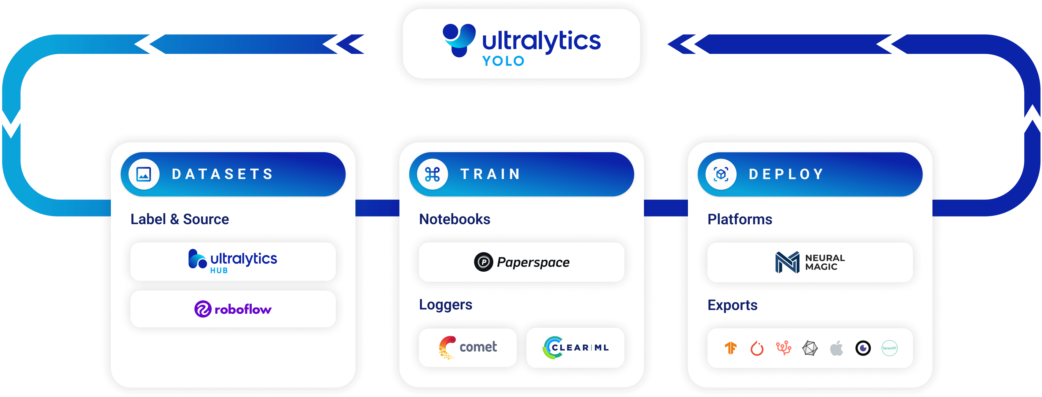
Yolo detection
https://docs.ultralytics.com/modes/train/

Slide 13
Yolo detection
https://docs.ultralytics.com/modes/train/
Why Choose Ultralytics YOLO for Training?
Here are some compelling reasons to opt for YOLOv8's Train mode:
Efficiency: Make the most out of your hardware, whether you're on a single-GPU setup or scaling across multiple GPUs.
Versatility: Train on custom datasets in addition to readily available ones like COCO, VOC, and ImageNet.
User-Friendly: Simple yet powerful CLI and Python interfaces for a straightforward training experience.
Hyperparameter Flexibility: A broad range of customizable hyperparameters to fine-tune model performance.

Slide 14
Yolo detection
https://docs.ultralytics.com/modes/train/
Key Features of Train Mode
The following are some notable features of YOLOv8's Train mode:
Automatic Dataset Download: Standard datasets like COCO, VOC, and ImageNet are downloaded automatically on first use.
Multi-GPU Support: Scale your training efforts seamlessly across multiple GPUs to expedite the process.
Hyperparameter Configuration: The option to modify hyperparameters through YAML configuration files or CLI arguments.
Visualization and Monitoring: Real-time tracking of training metrics and visualization of the learning process for better insights.

Slide 15
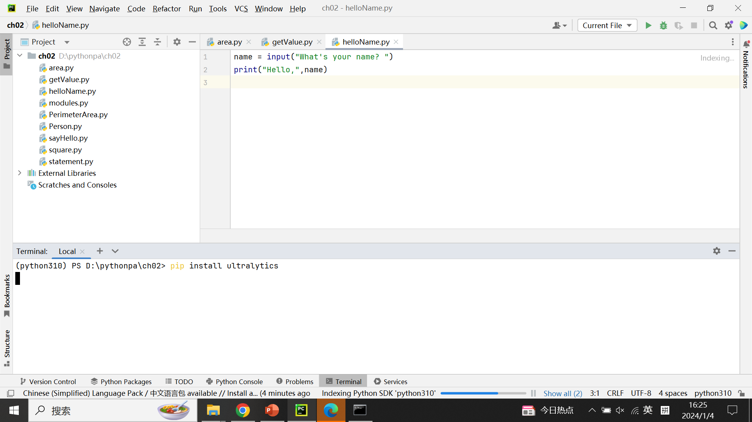
Yolo detection
Install YOLO package: pip install ultralytics

Slide 16
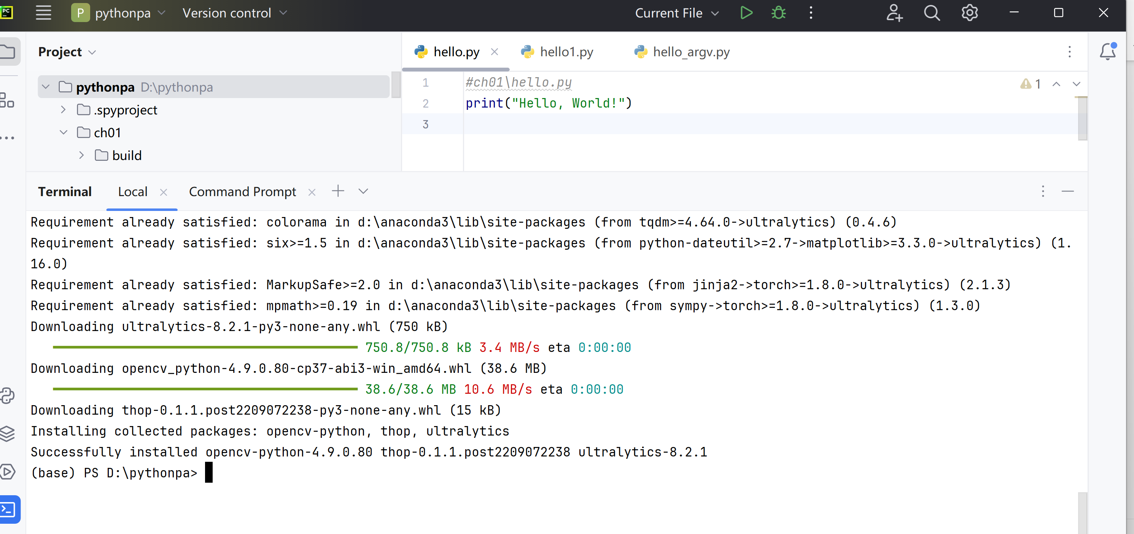
Yolo detection

Slide 17
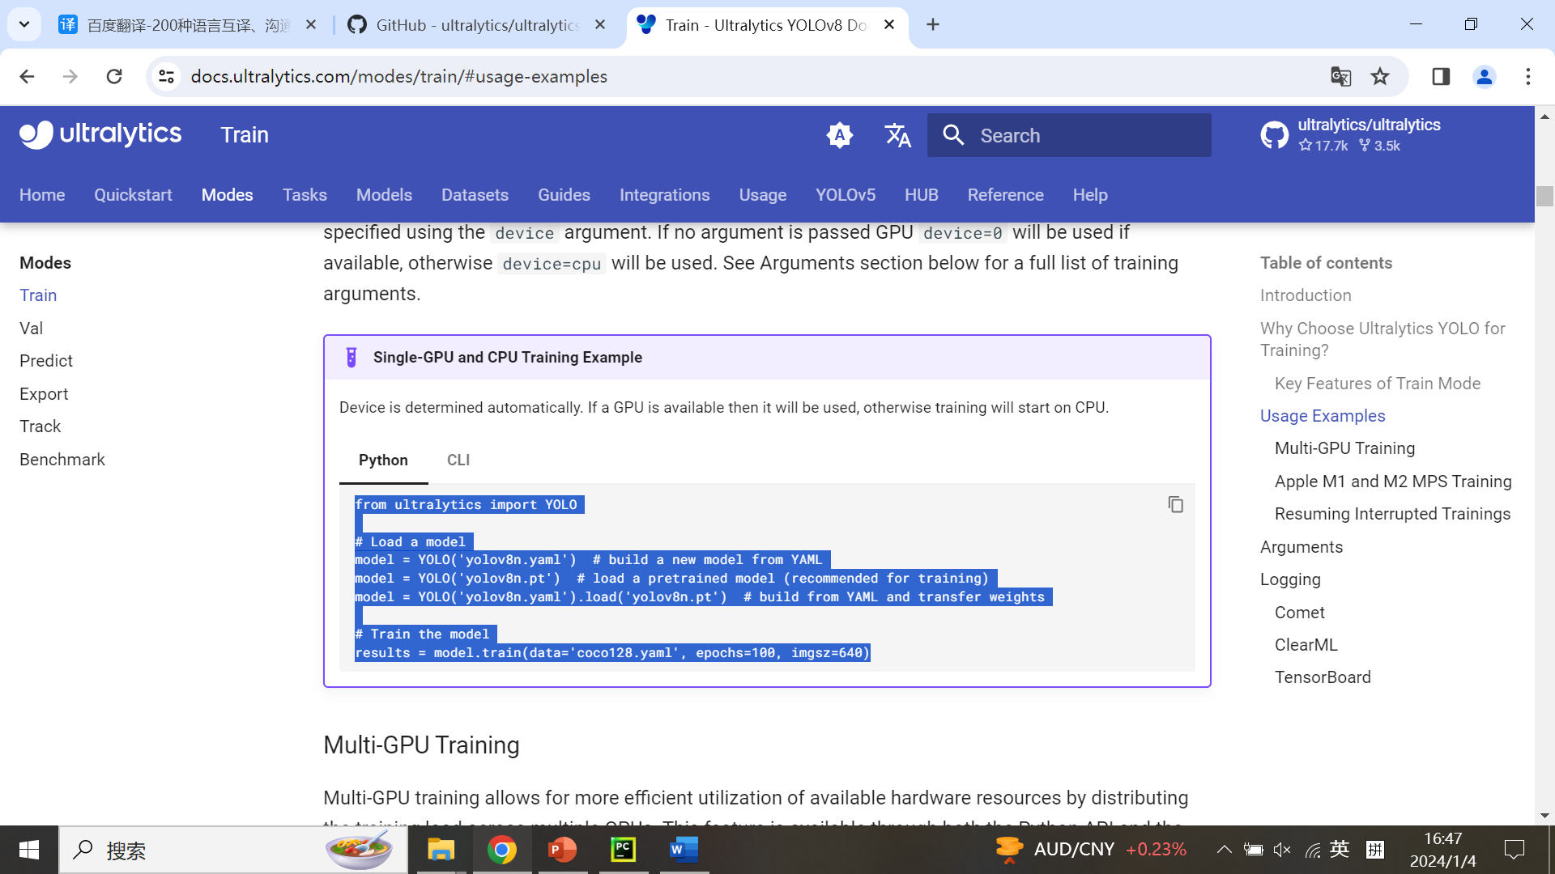
Yolo detection
https://docs.ultralytics.com/modes/train/#usage-examples

Slide 18
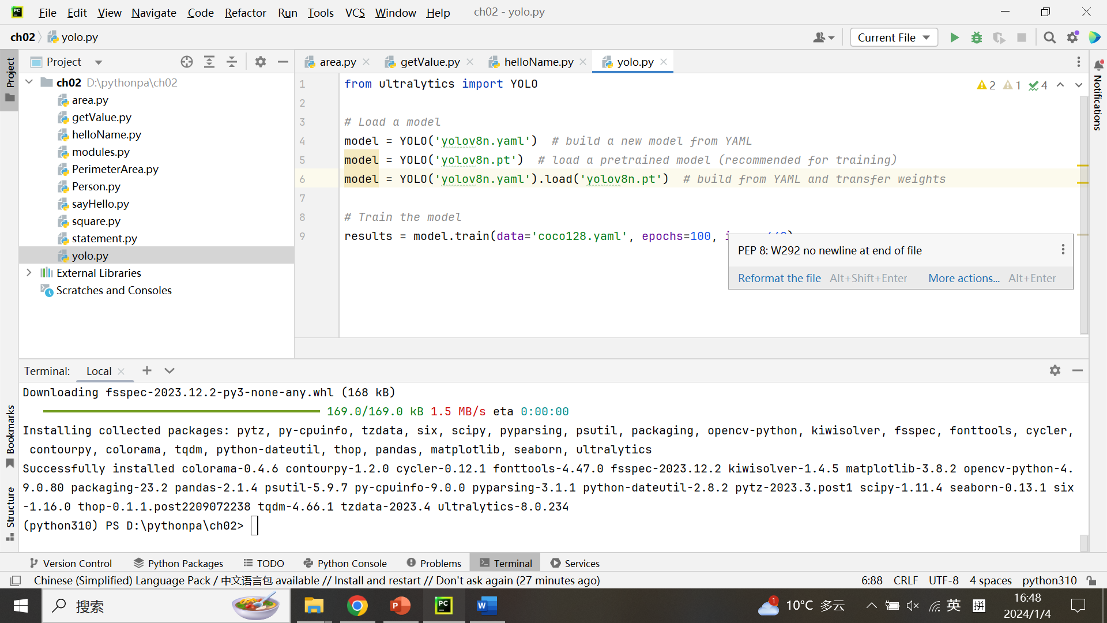
Yolo detection
Create a new file.

Slide 19
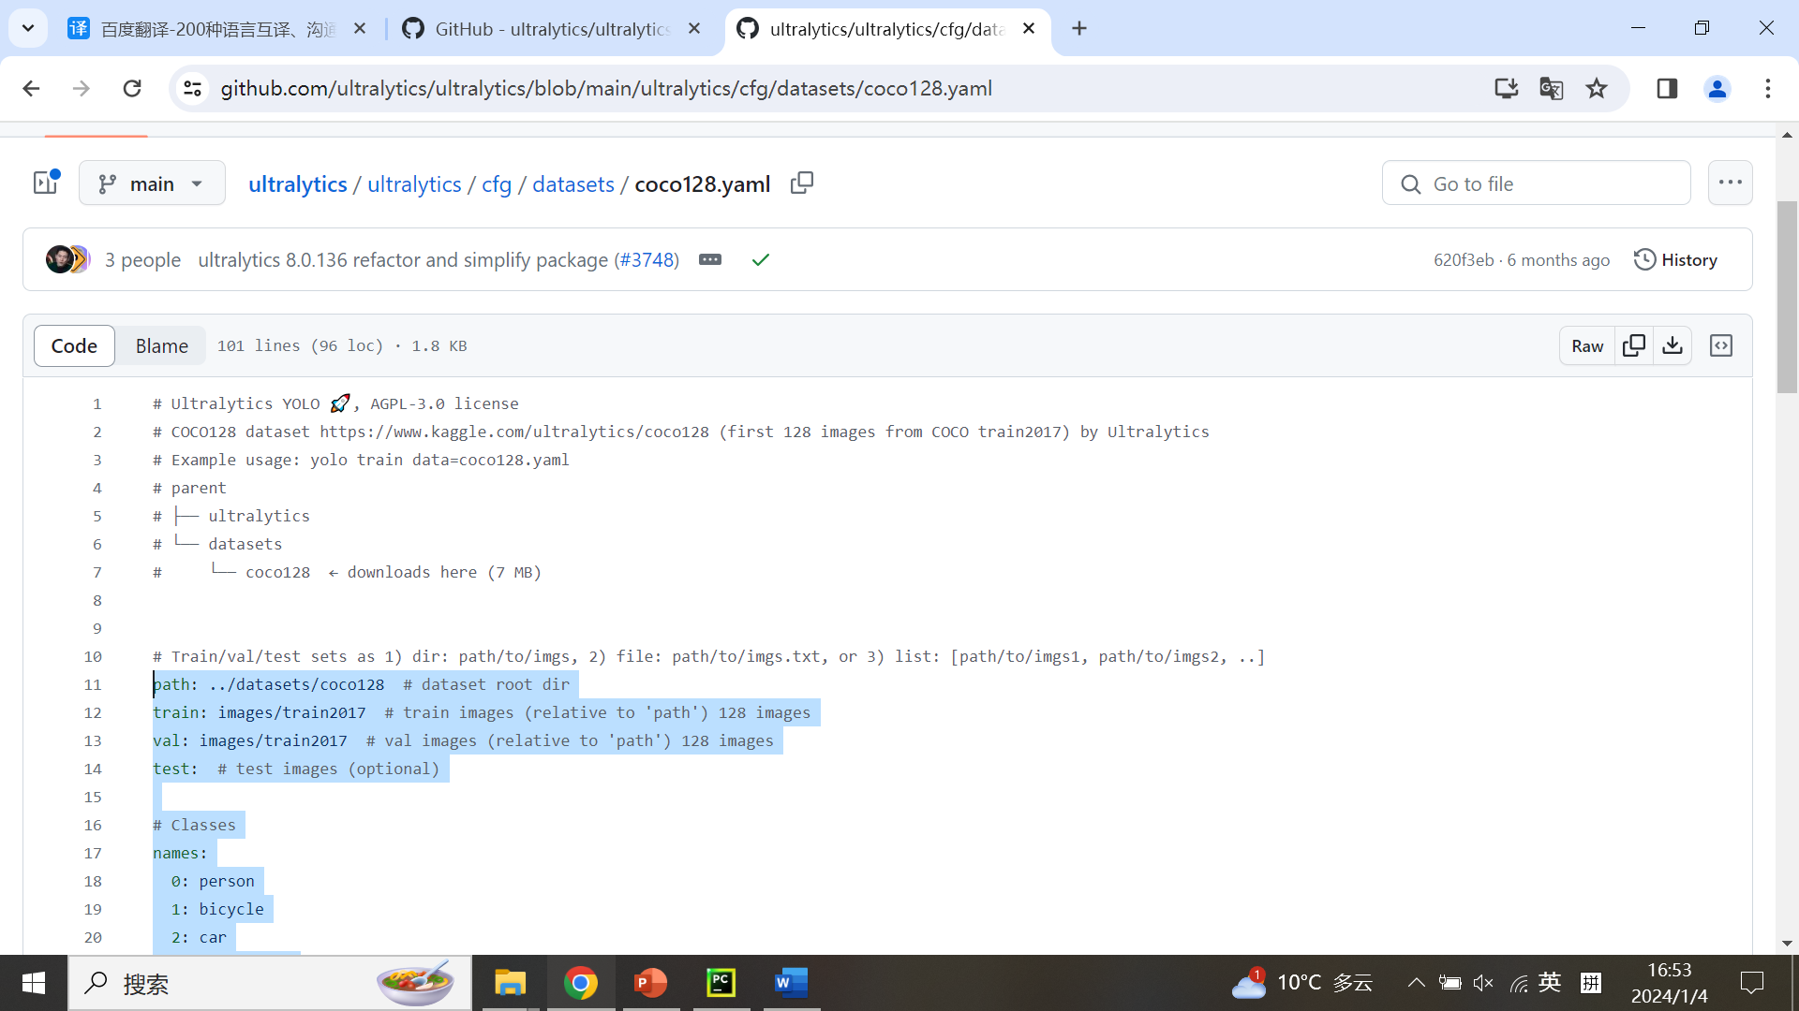
Yolo detection

Slide 20
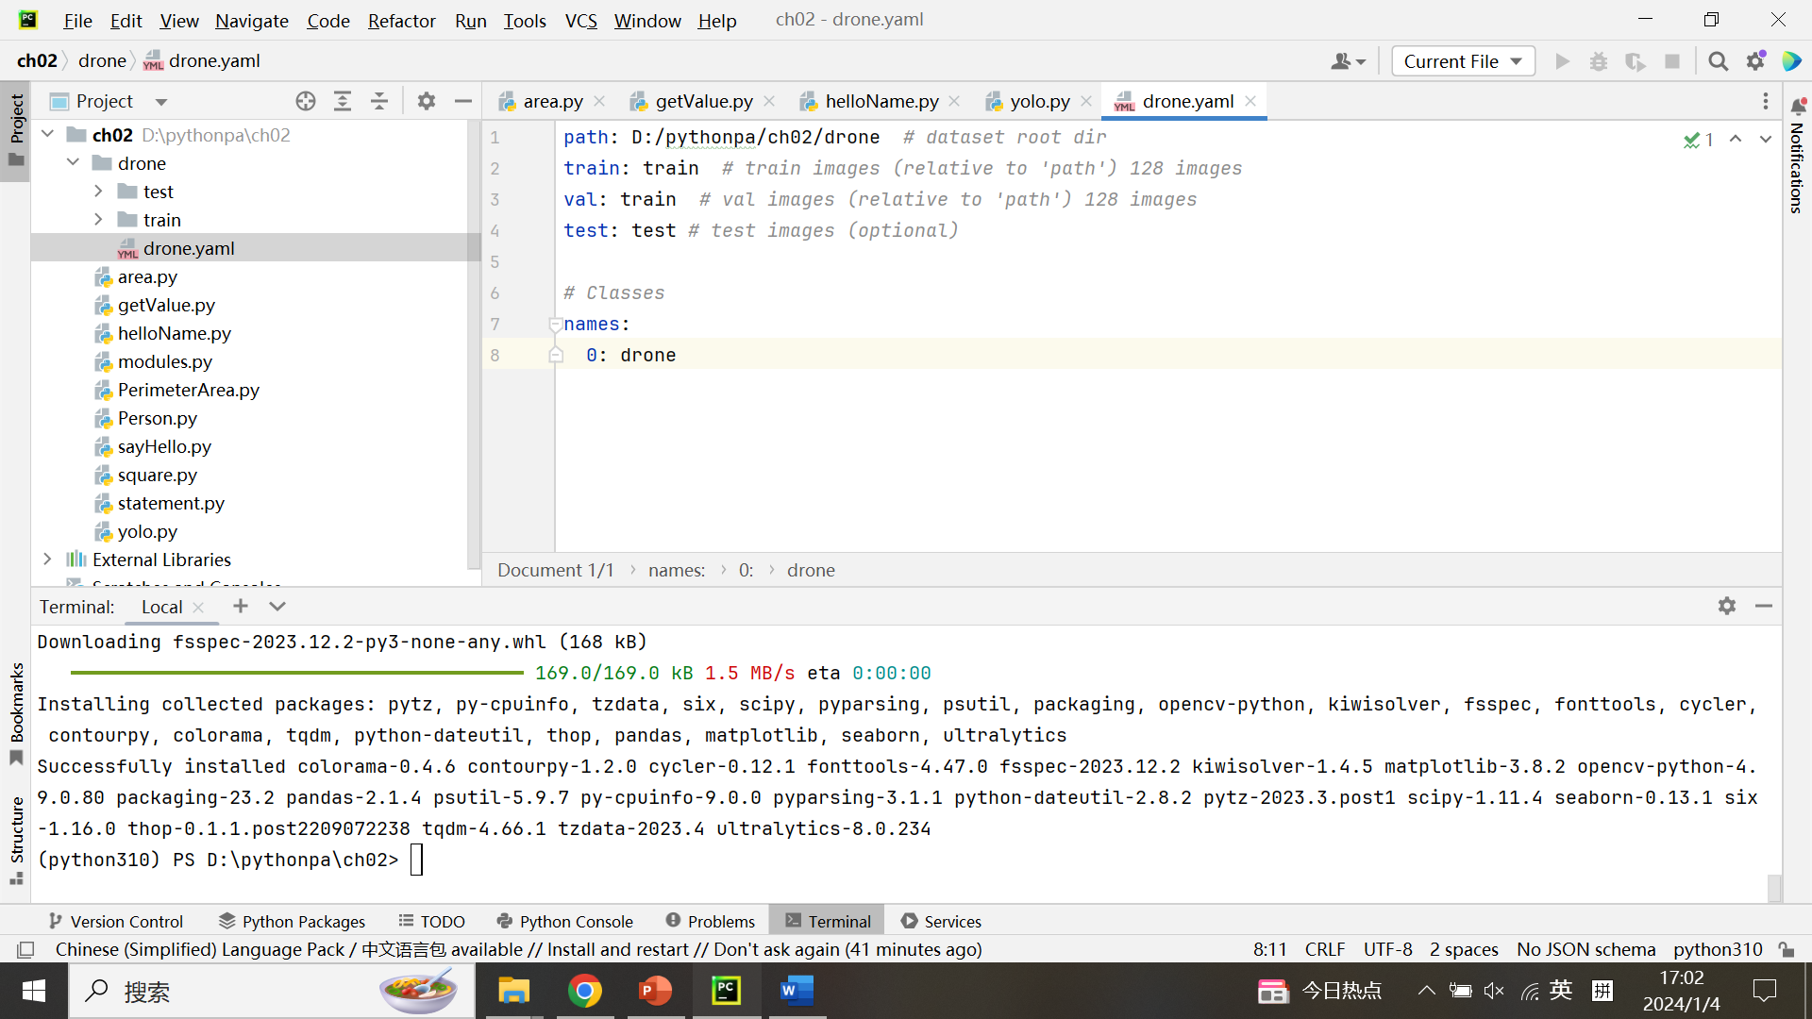
Yolo detection

Slide 21
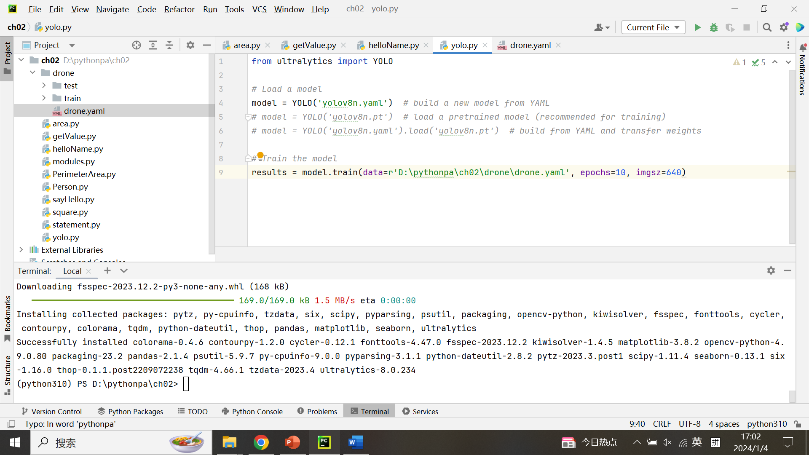
Yolo detection

Slide 22
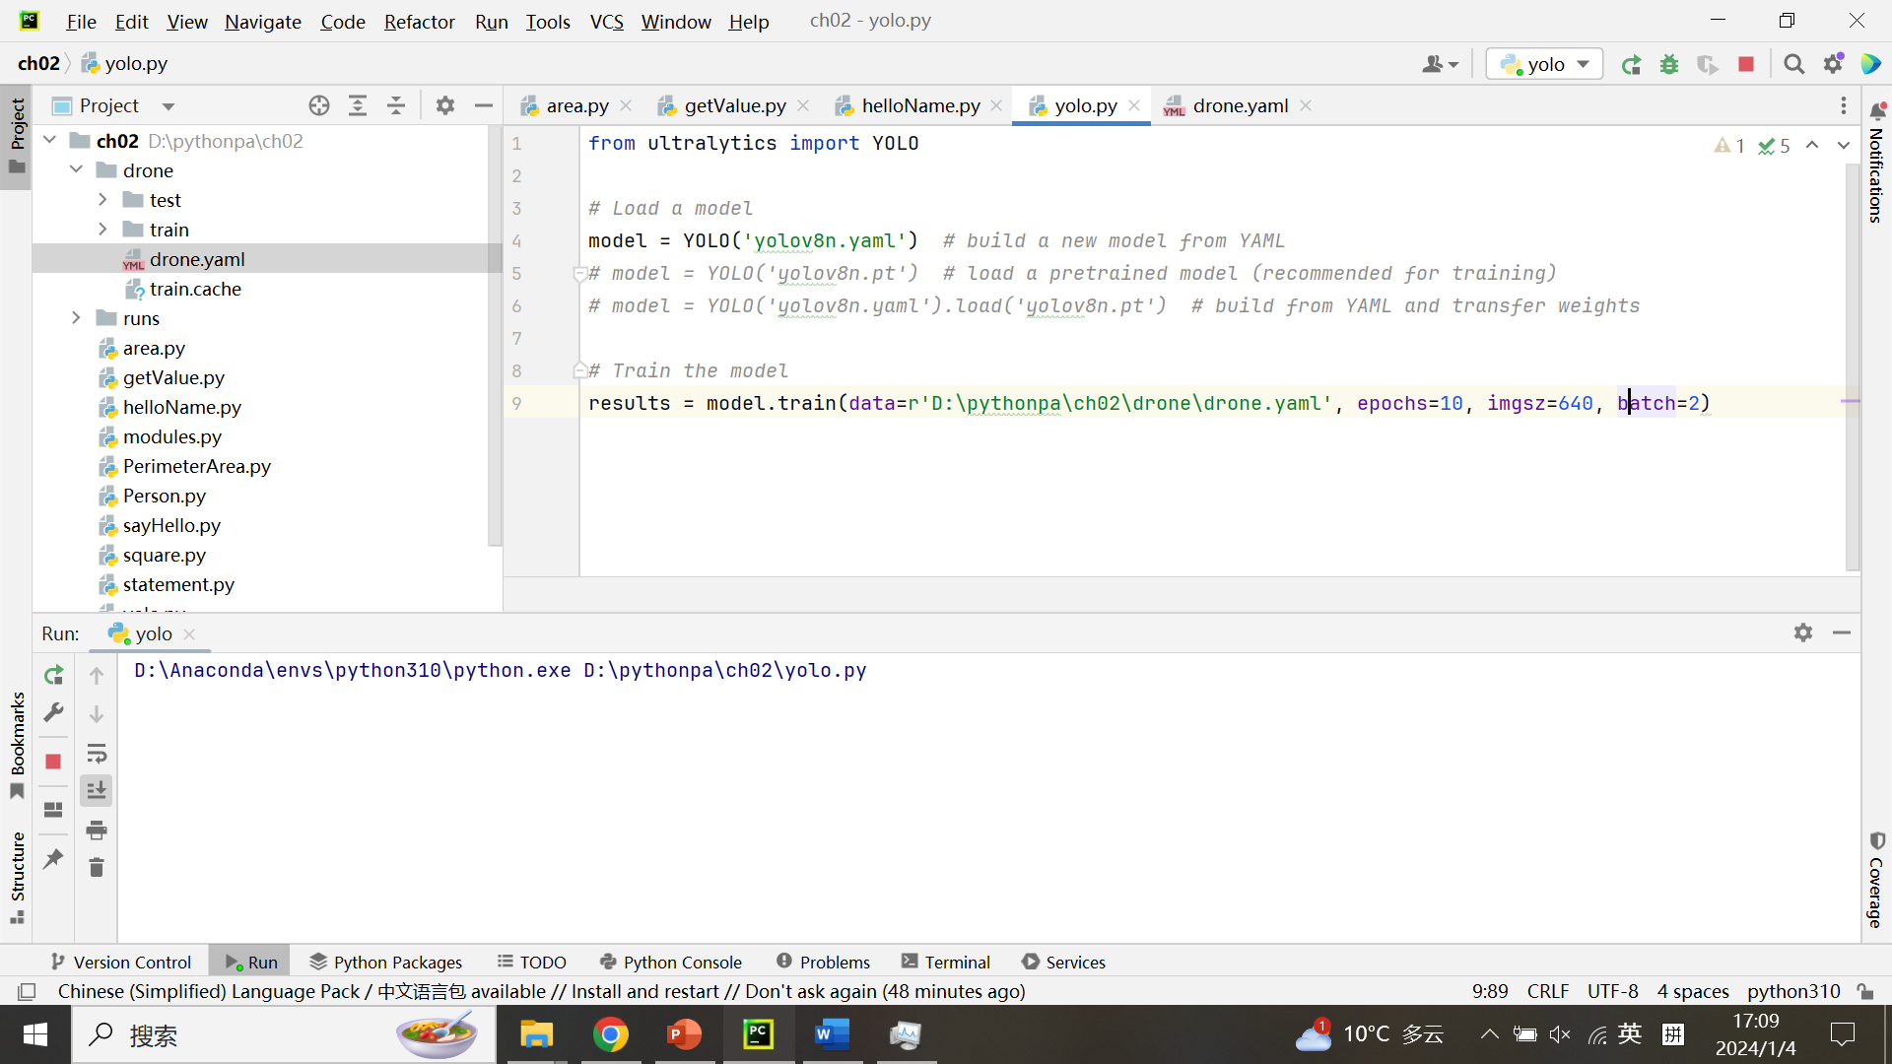
Yolo detection

Slide 23
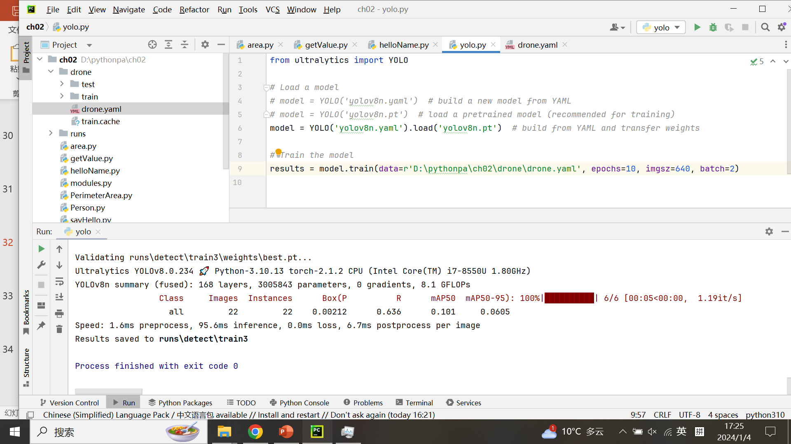
Yolo detection

Slide 24
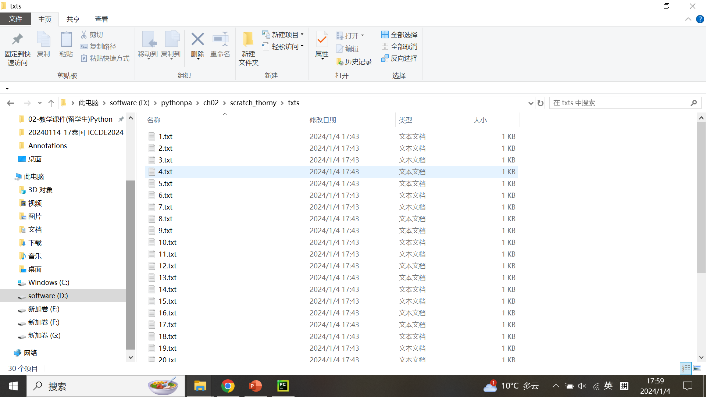
Yolo detection

Slide 25
The minist database
THE MNIST DATABASE
of handwritten digits
http://yann.lecun.com/exdb/mnist

Slide 26
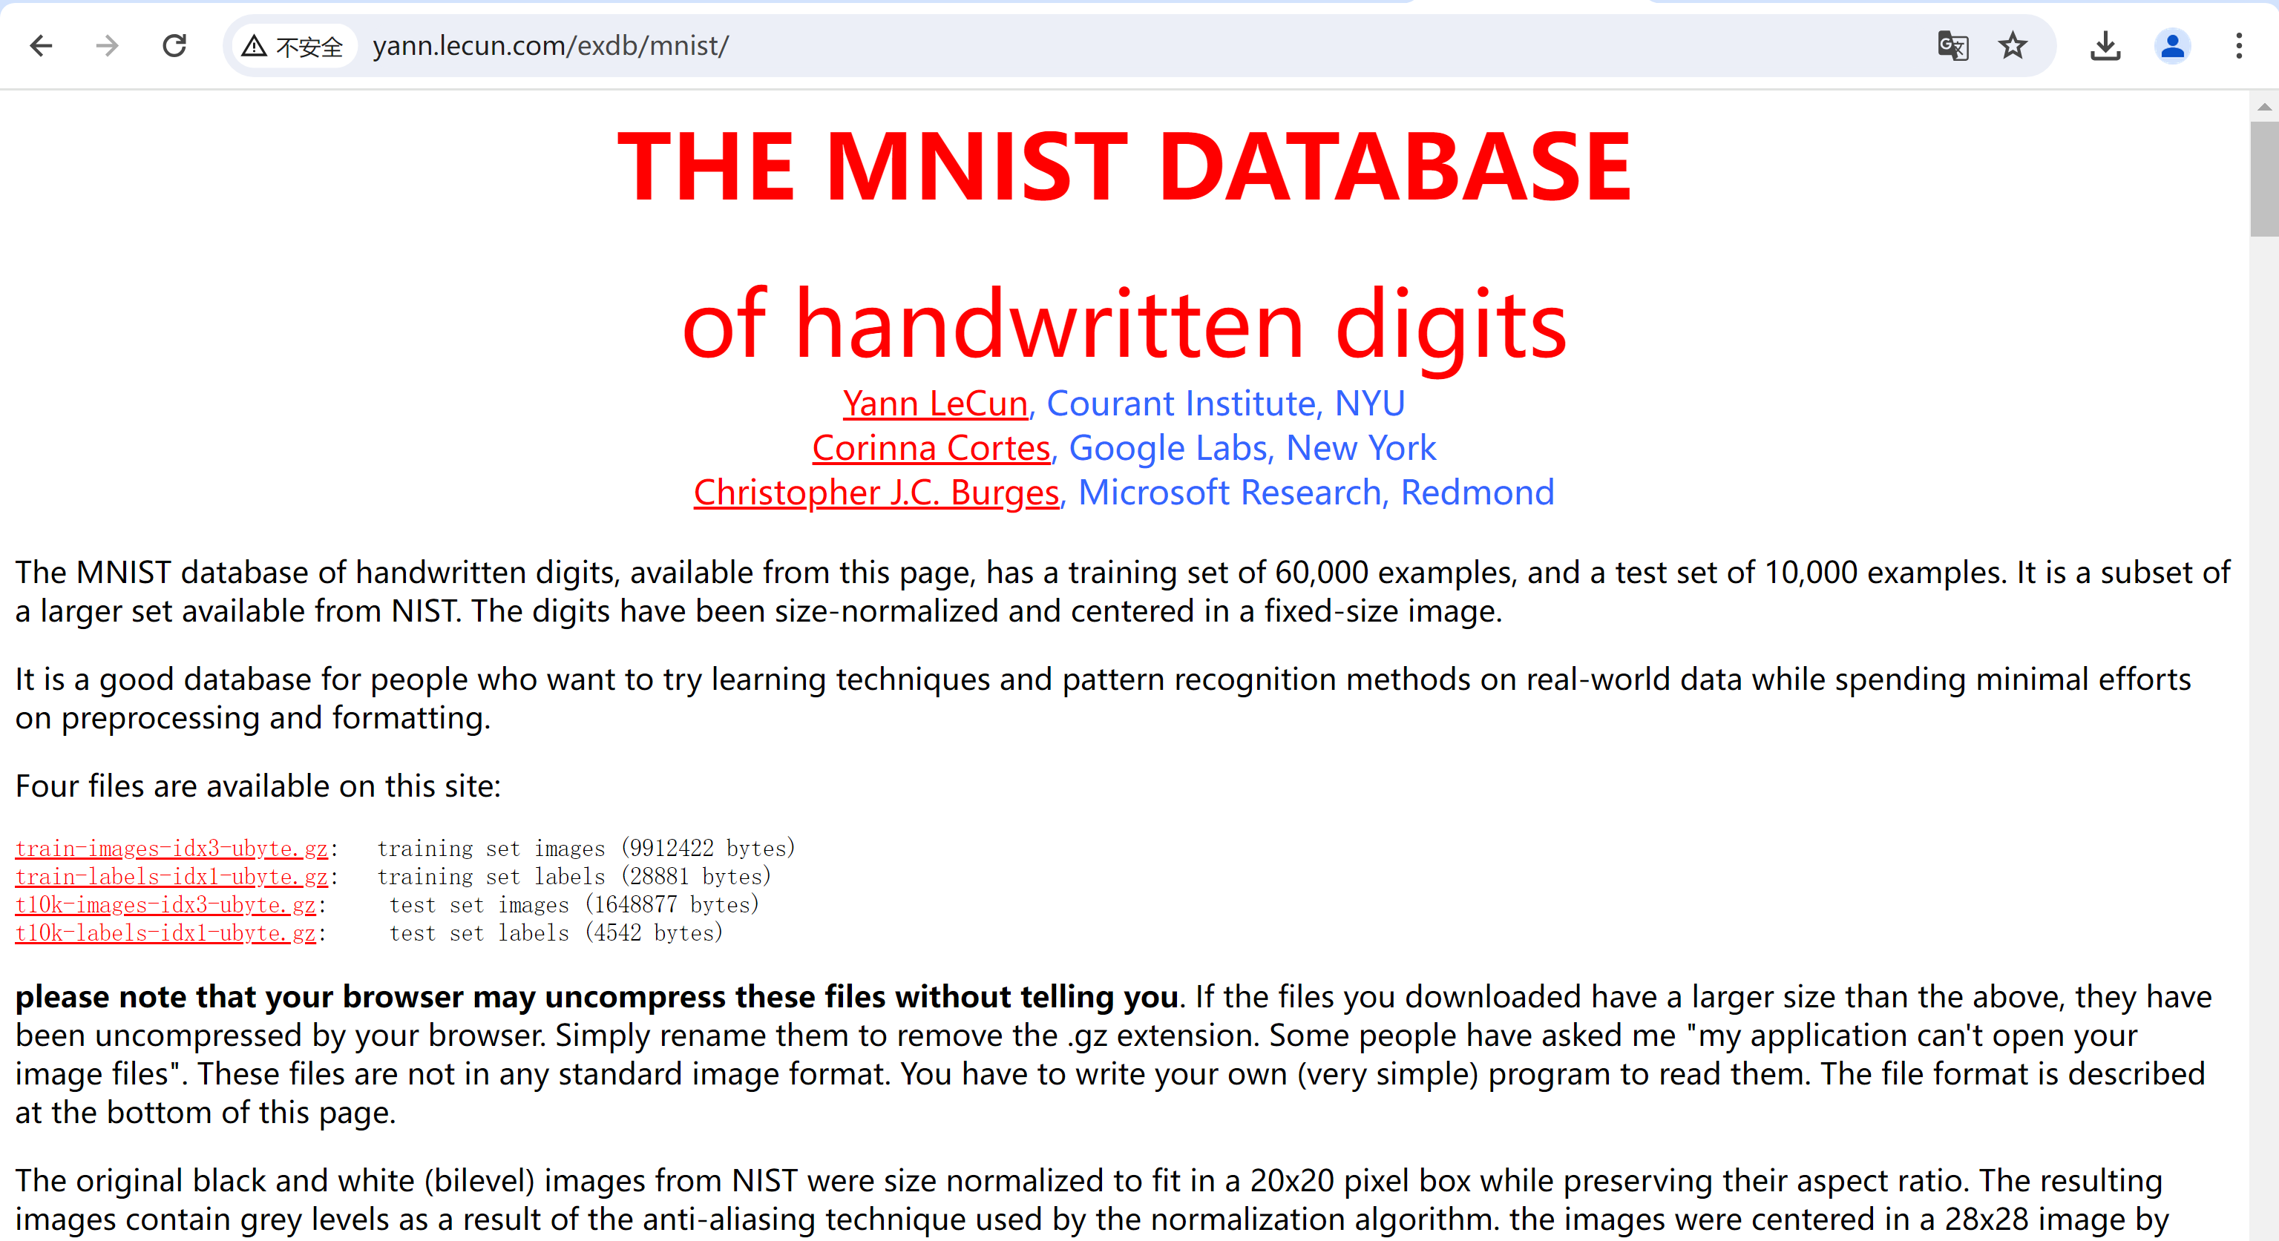
The minist database

Slide 27
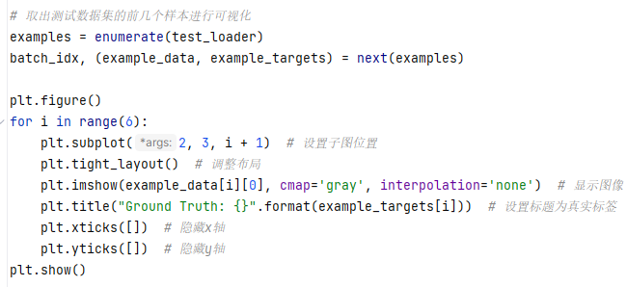
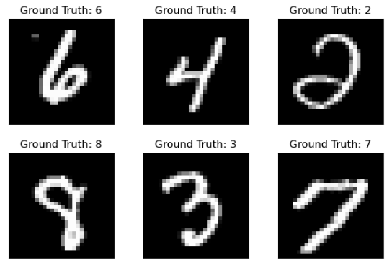
The minist database
Pytorch handwritten digits recognition – get MNIST dataset for visualization

Slide 28
The minist database
Pytorch handwritten digits recognition – get MNIST dataset for visualization
import torch import torchvision from torch.utils.data import DataLoader import torch.nn as nn import torch.nn.functional as F import torch.optim as optim import matplotlib.pyplot as plt import os os.makedirs('./mnist_result/torch/', exist_ok=True)
# 设置训练参数 n_epochs = 3 # 训练轮数 batch_size_train = 64 # 训练时的批次大小 batch_size_test = 1000 # 测试时的批次大小 learning_rate = 0.01 # 学习率 log_interval = 10 # 打印训练信息的间隔 random_seed = 1 # 设置随机种子以确保结果可复现 torch.manual_seed(random_seed) # 手动设置随机种子

Slide 29
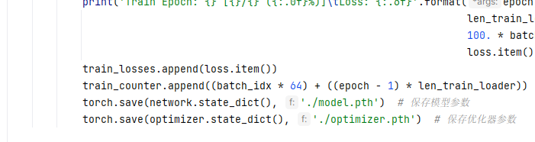
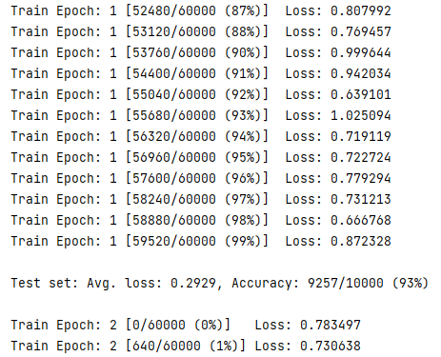
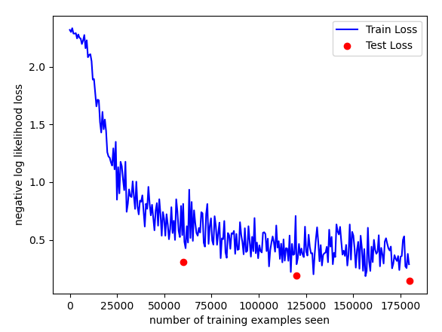
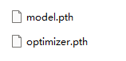
The minist database

Slide 30
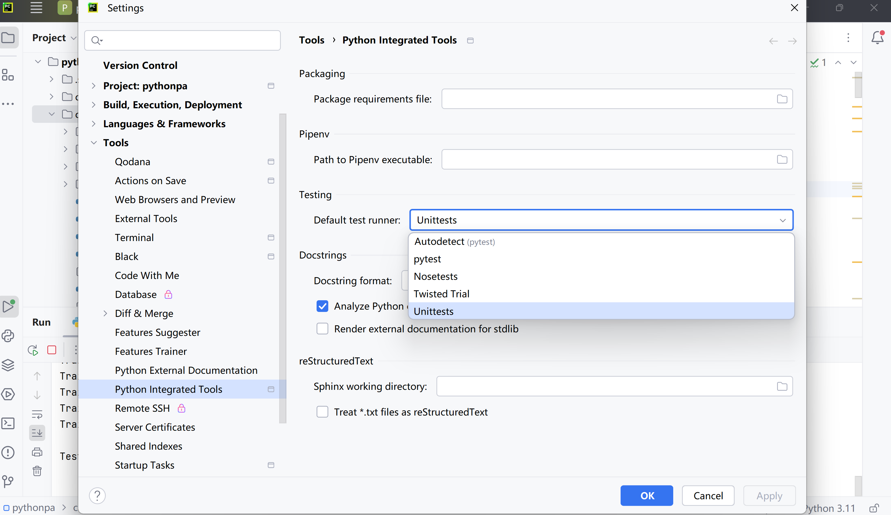
The minist database

Slide 31
Paddle paddle install
百度飞桨 PaddlePaddle Install
https://www.paddlepaddle.org.cn/en

Slide 32
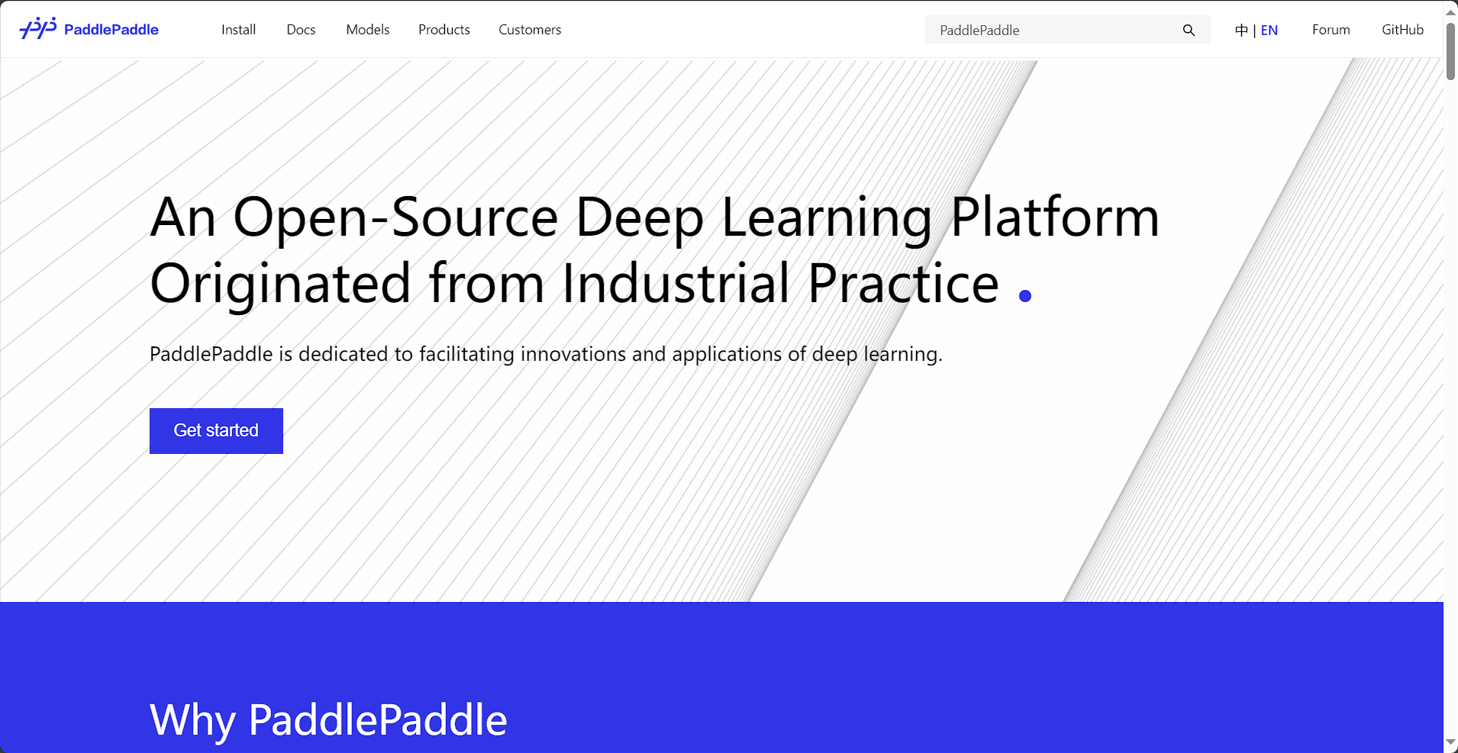
Paddle paddle install
百度飞桨 PaddlePaddle
https://www.paddlepaddle.org.cn/en

Slide 33
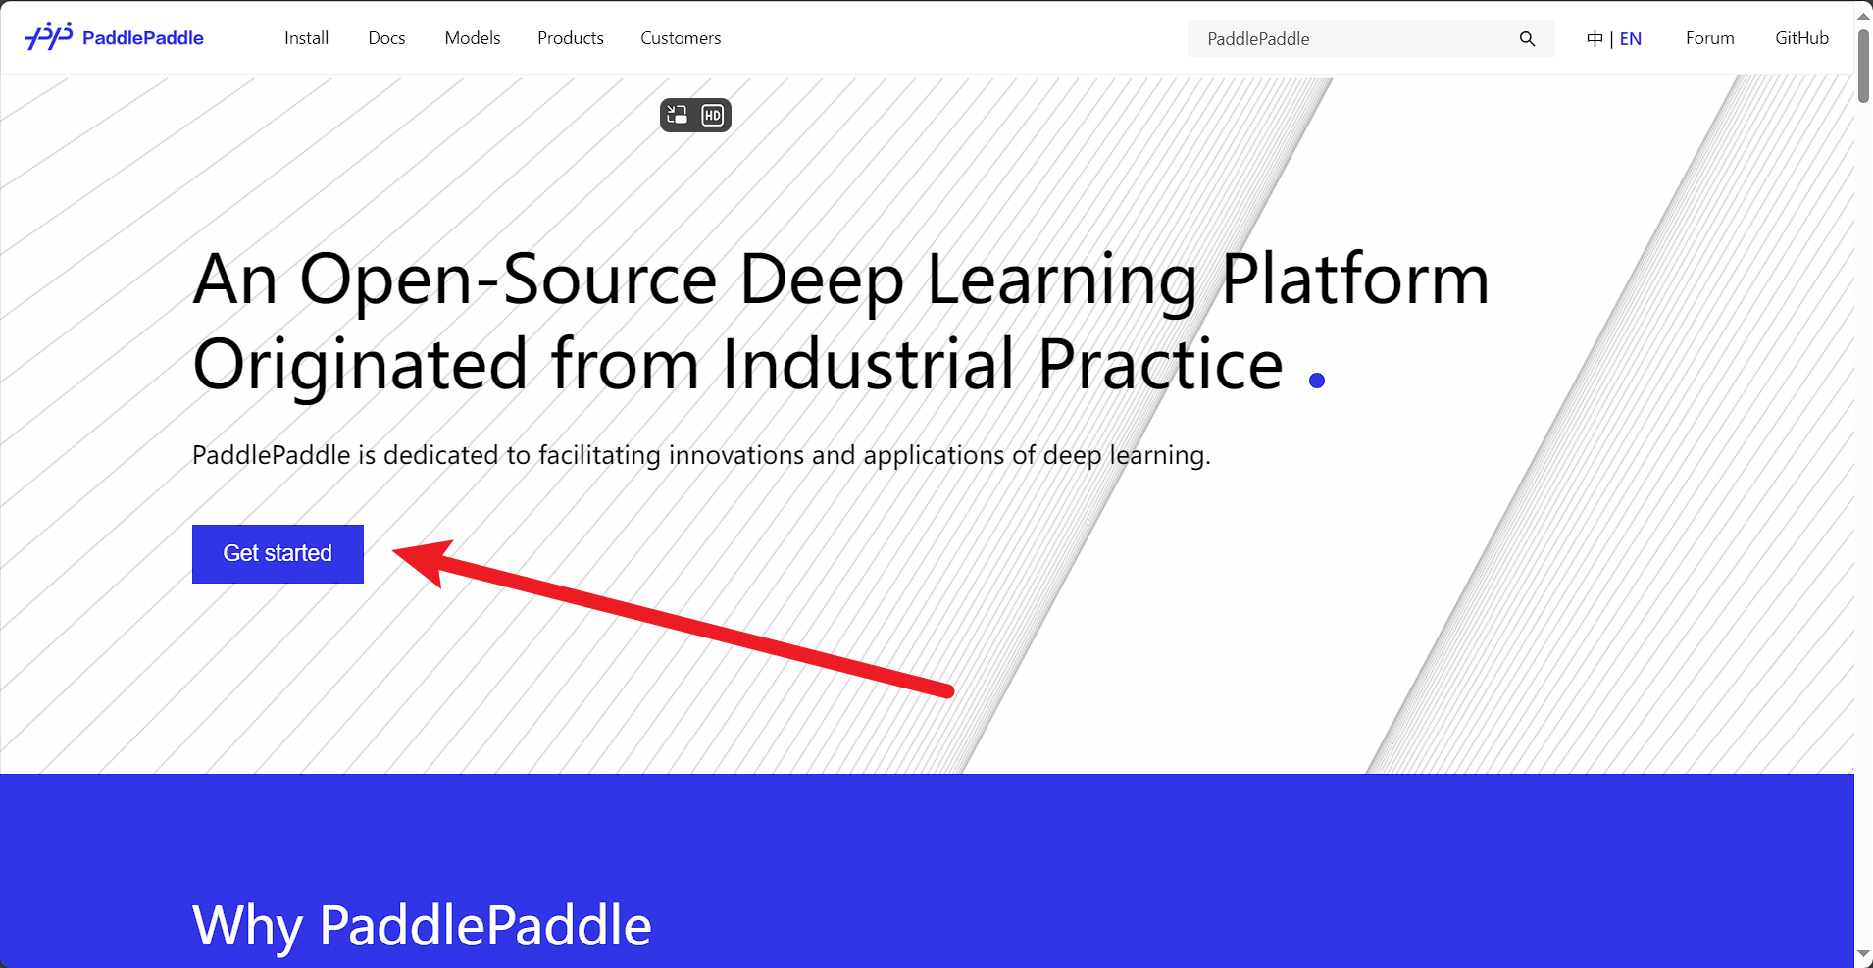
Paddle paddle install
百度飞桨PaddlePaddle -Install
https://www.paddlepaddle.org.cn/en

Slide 34
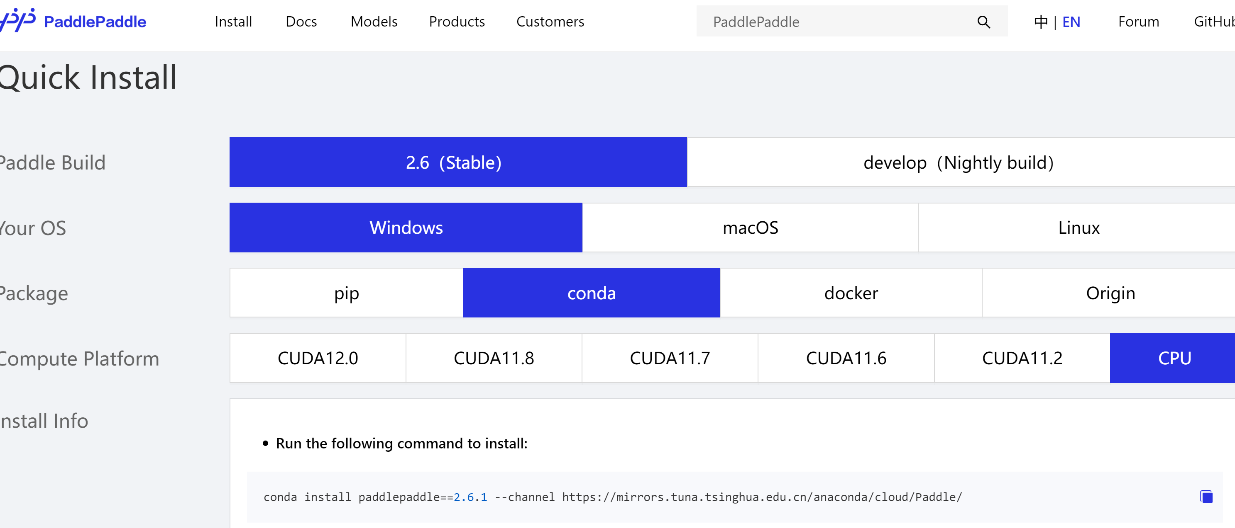
Paddle paddle install
百度飞桨PaddlePaddle -Install
https://www.paddlepaddle.org.cn/en/install/quick?docurl=/documentation/docs/en/install/conda/windows-conda_en.html

Slide 35
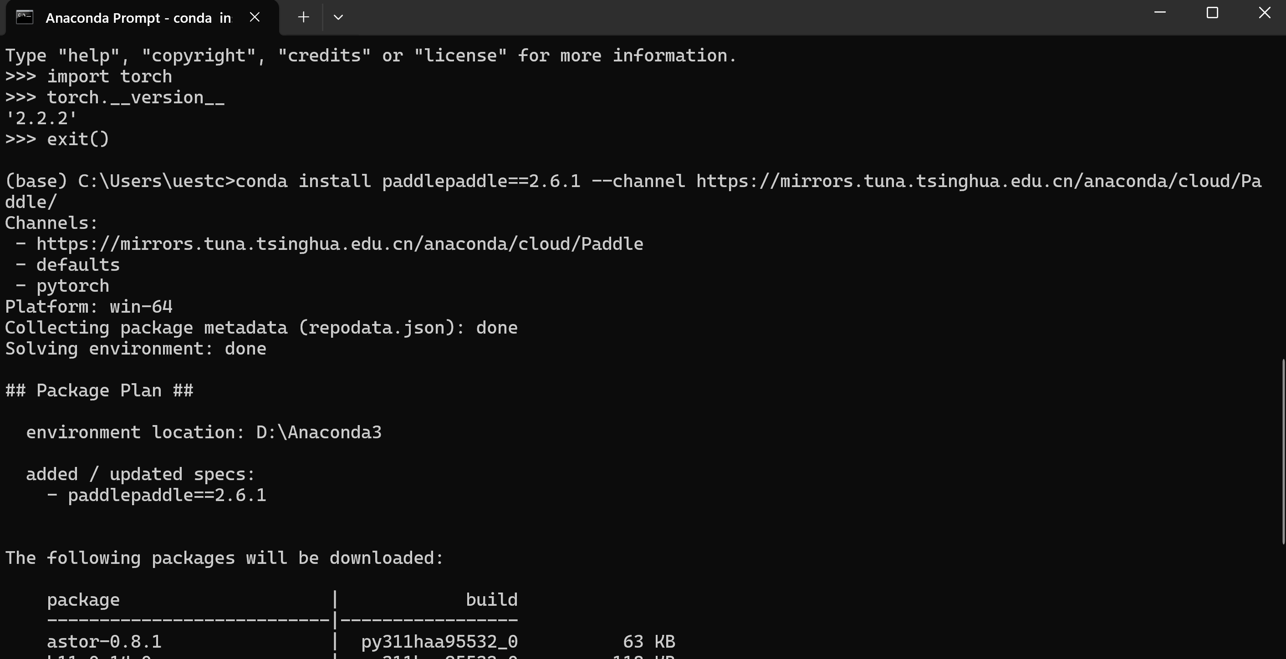
Paddle paddle install
百度飞桨PaddlePaddle -Install
conda install paddlepaddle==2.6.1 --channel https://mirrors.tuna.tsinghua.edu.cn/anaconda/cloud/Paddle/

Slide 36
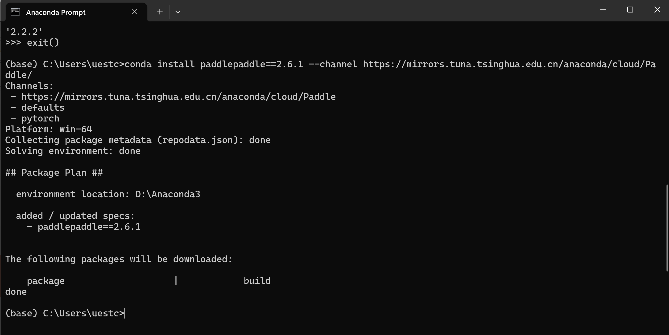
Paddle paddle install
百度飞桨PaddlePaddle -Install
conda install paddlepaddle==2.6.1 --channel https://mirrors.tuna.tsinghua.edu.cn/anaconda/cloud/Paddle/

Slide 37
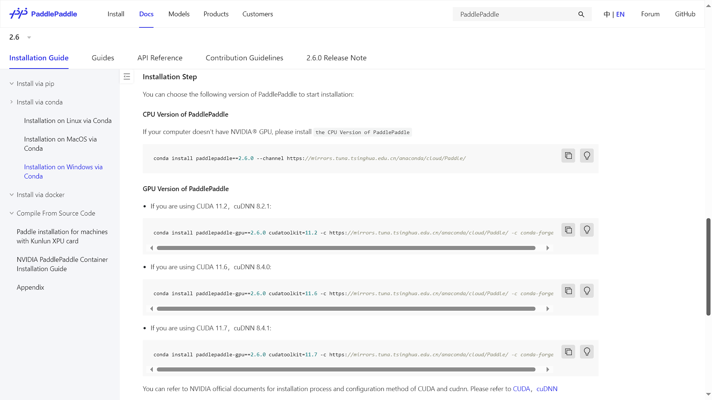
Paddle paddle install
百度飞桨PaddlePaddle -Install
https://www.paddlepaddle.org.cn/documentation/docs/zh/install/conda/windows-conda.html#anchor-0

Slide 38
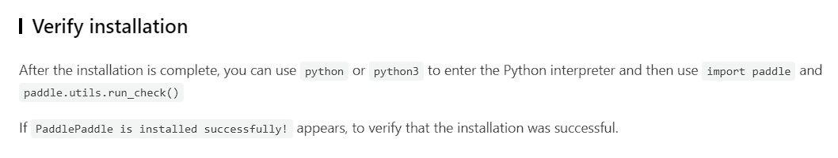
Paddle paddle install
百度飞桨PaddlePaddle -Install

Slide 39
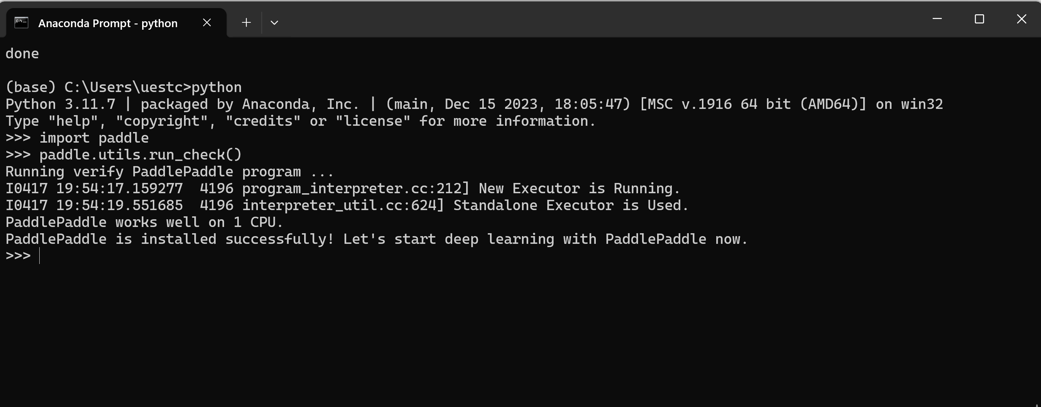
Paddle paddle install
PaddlePaddle -Install success

Slide 40
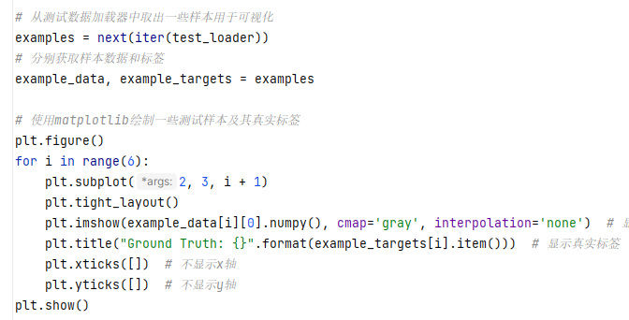
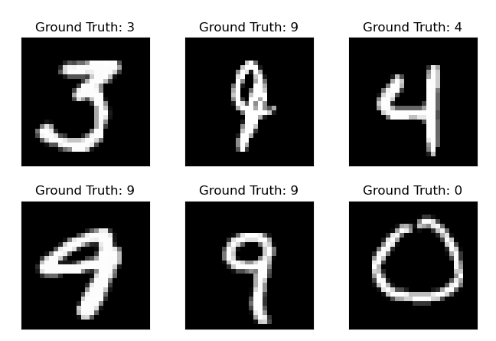
The minist database
Paddle handwritten digits recognition – get MNIST dataset for visualization

Slide 41
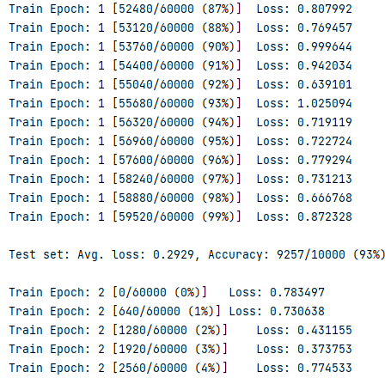
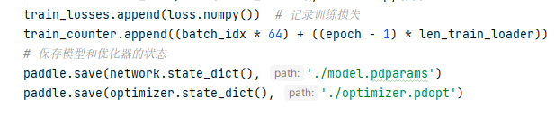
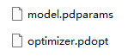
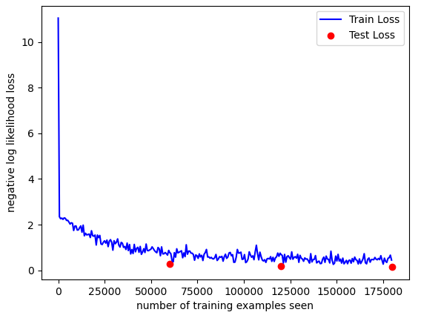
The minist database
Paddle– MNIST dataset train 3 times

Slide 42
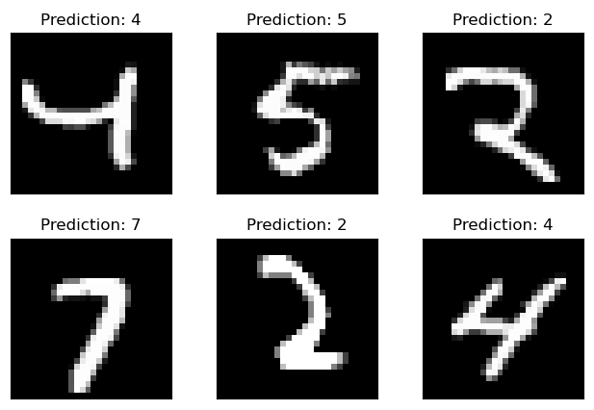
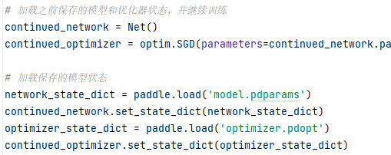
The minist database
Paddle handwritten digits recognition
Create don’t train network , load network parameters

Slide 43
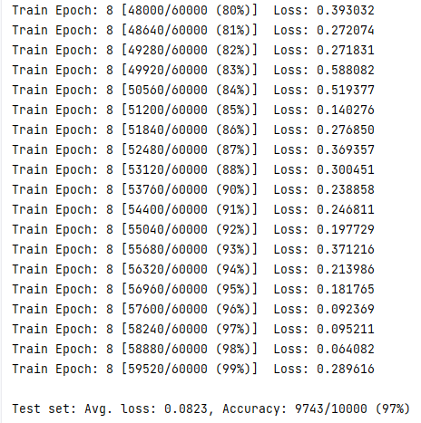
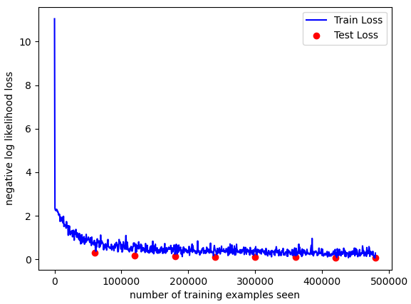
The minist database
Paddle handwritten digits recognition, after train 5 times

Slide 44
TensorFlow install
TensorFlow Install
https://tensorflow.google.cn

Slide 45
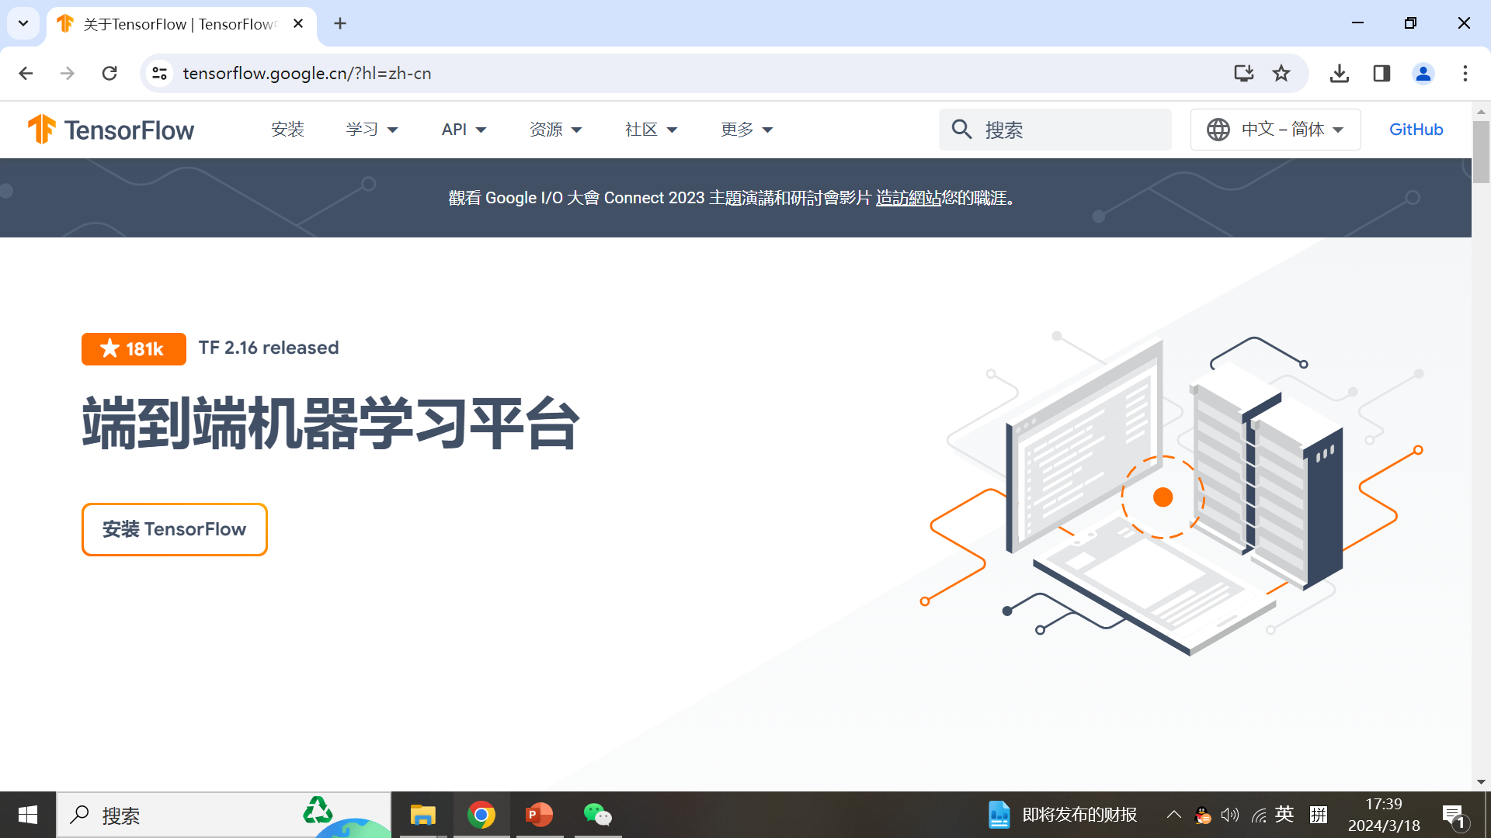
TensorFlow install

Slide 46
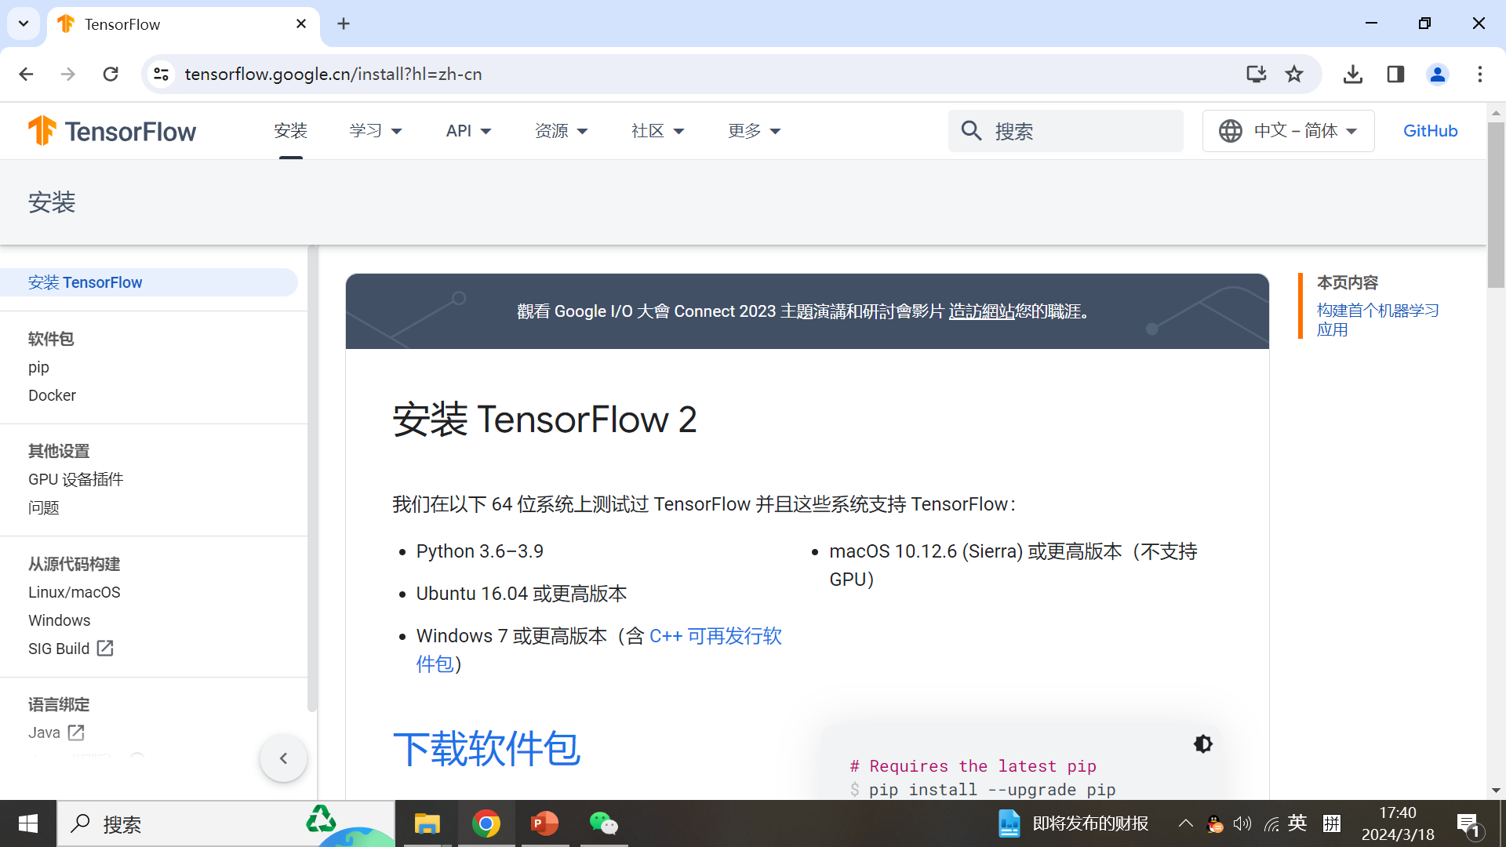
TensorFlow install

Slide 47
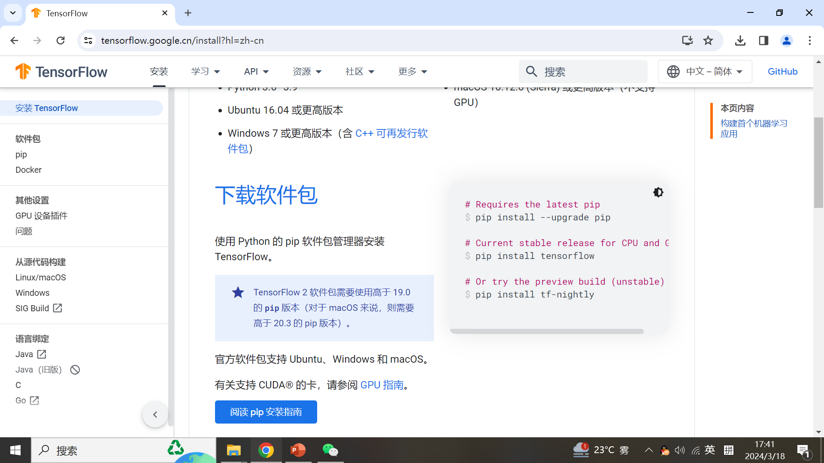
TensorFlow install

Slide 48
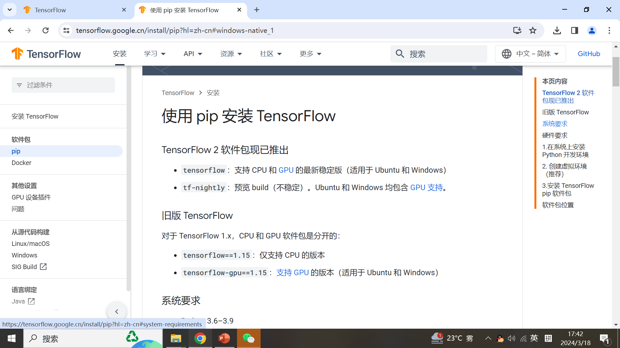
TensorFlow install

Slide 49
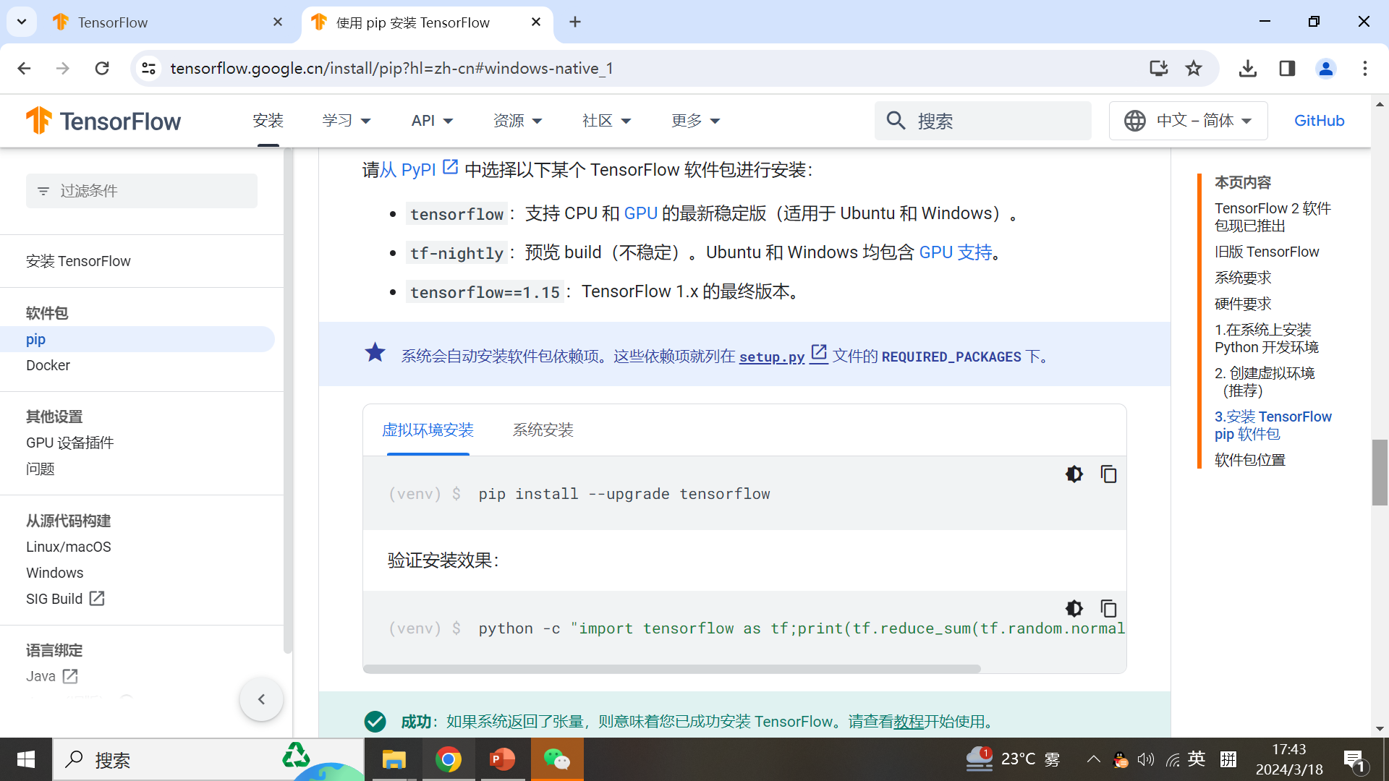
TensorFlow install

Slide 50
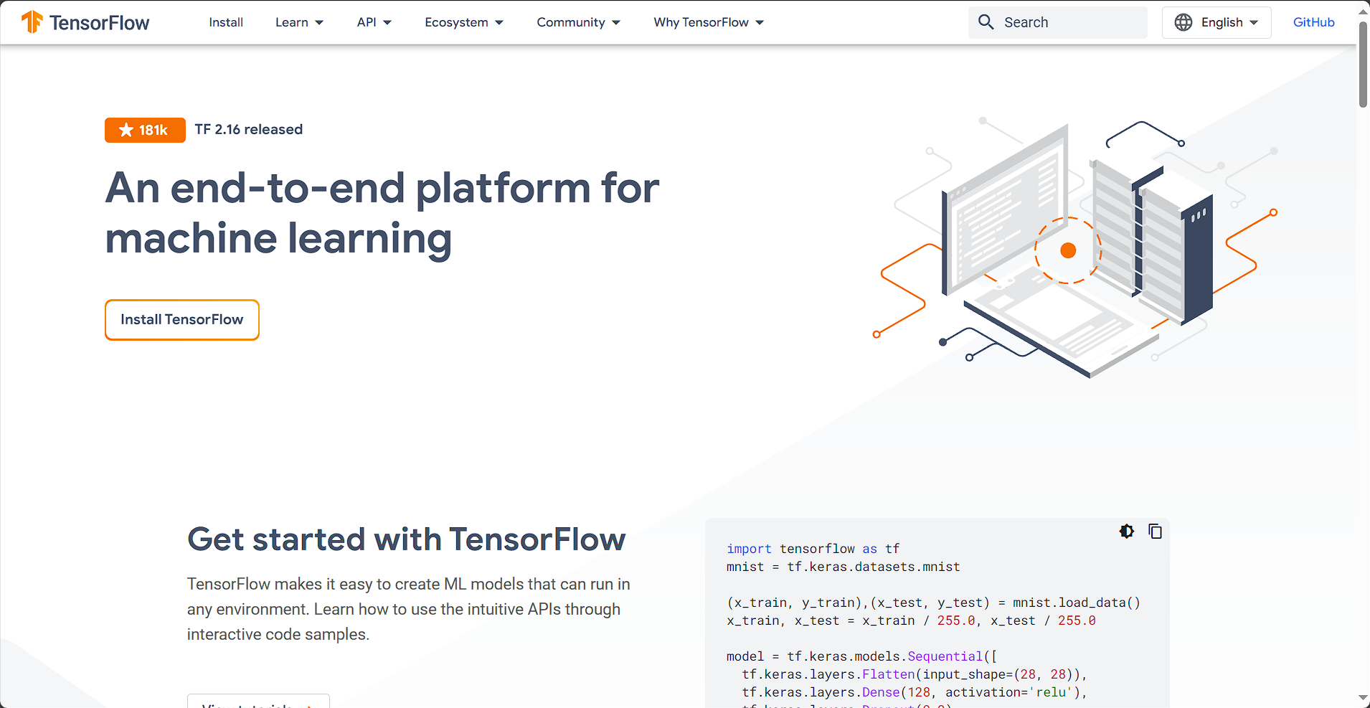
TensorFlow install
https://tensorflow.google.cn/

Slide 51

TensorFlow install
https://tensorflow.google.cn/

Slide 52

TensorFlow install
https://tensorflow.google.cn/install

Slide 53

TensorFlow install
https://tensorflow.google.cn/install/pip#windows-native_1

Slide 54

TensorFlow install
https://tensorflow.google.cn/install/pip#windows-native_1

Slide 55

Thanks！
谢谢！

